Slide 1
CSC589 Introduction to Computer Vision Lecture 3
Gaussian Filter, Histogram Equalization
Bei Xiao

Slide 2
Last lecture
Image can represented as a matrix
Point process
Linear filter: convolution

Slide 3
Take-home assignments
Chapter 3.2 on linear filtering
Image Histogram Equalization (pdf will be uploaded in blackboard)
Chapter 1 of Solem (Computer vision with Python). Many useful examples
Homework will be out this weekend and due a week.

Slide 4
Today’s lecture
More on linear filter, Image Sharpening
Gaussian Filter (introduction)
Image Histogram Equalization
Basic image processing tutorial

Slide 5
Last time we talked about convolution

Slide 10
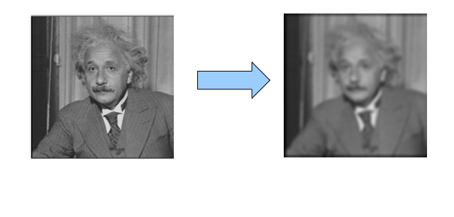
Image Sharpening
Take this image and blur it

Slide 11
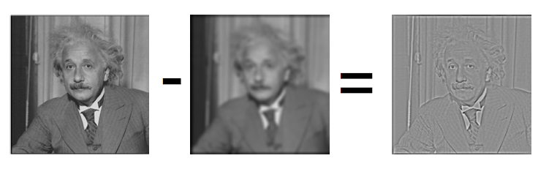
Image Sharpening
What do we get if we subtract this two?
This is the left-over sharp stuff!

Slide 12
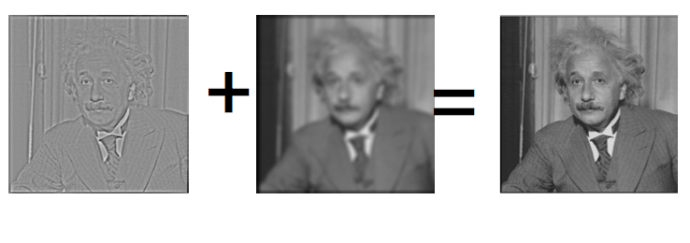
Let’s make the image sharper?
We know: “sharp stuff + blurred = original”

Slide 13
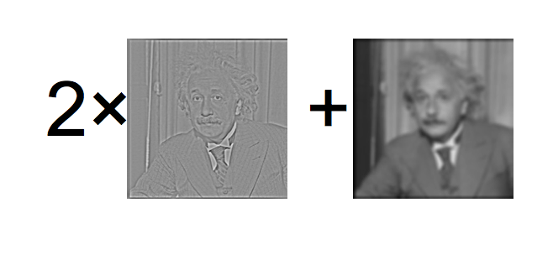
Let’s boost the sharp stuff a little

Slide 14
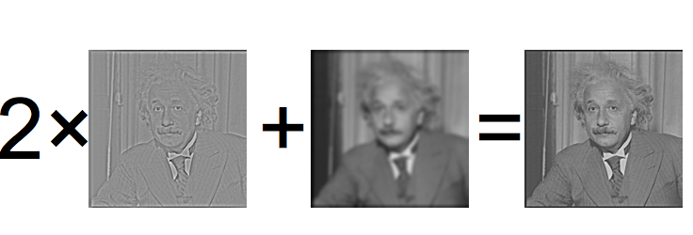
Let’s boost the sharp stuff a little

Slide 15
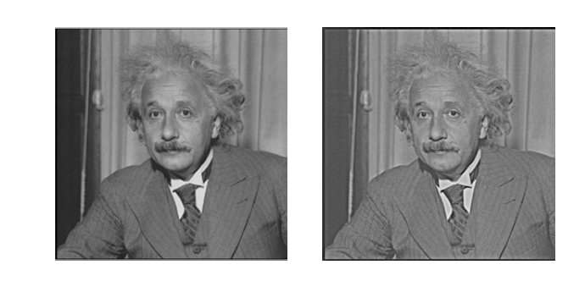
Side by Side

Slide 16
Now look at the computation
Operations
1 convolution
1 subtraction over the whole image
As an equation:

Slide 17
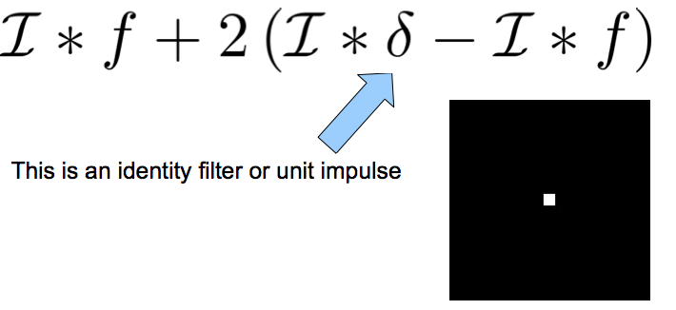
Rewrite this

Slide 18
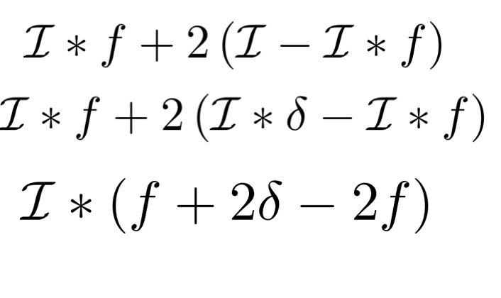
Rewrite this

Slide 19
Now look at the computation
Can pre-compute new filter
Operations
1 convolution

Slide 20
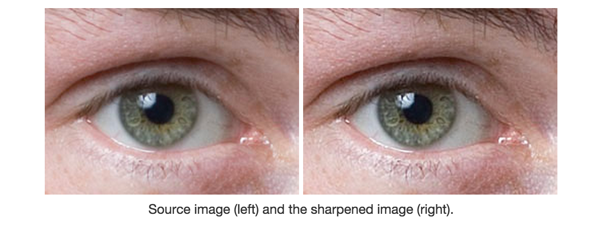
Photoshop: Unsharp Masknig
http://en.wikipedia.org/wiki/Unsharp_masking

Slide 21
Unsharp Masking (Scipy)
alpha = 30
im_blur = filters.gaussian_filter(im, 3)
im_blur2 = filters.gaussian_filter(im_blur,1)
im_sharpened = im_blur + alpha * (im_blur - im_blur2)

Slide 22
Unsharp Masking (Scikit)

Slide 23
Unsharp Masking (MATLAB)
a = imread(‘rice.png’)
imshow(a)
b = imsharpen(a,’Radius’,2, ‘Amount’,1);
Imshow(b)

Slide 24
Your Convolution filter toolbox
90% of the filtering that you will do will be either
Smoothing (or Blurring)
High-Pass Filtering (will explain later)
Most common filters:
Smoothing: Gaussian
High Pass Filtering: Derivative of Gaussian

Slide 25
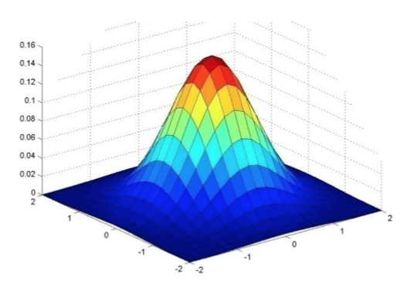
Gaussian Filter
Gaussian = normal distribution function

Slide 26
Gaussian Filter
Gaussian = normal distribution function

Slide 27
Gaussian Filter
Gaussian = normal distribution function

Slide 28
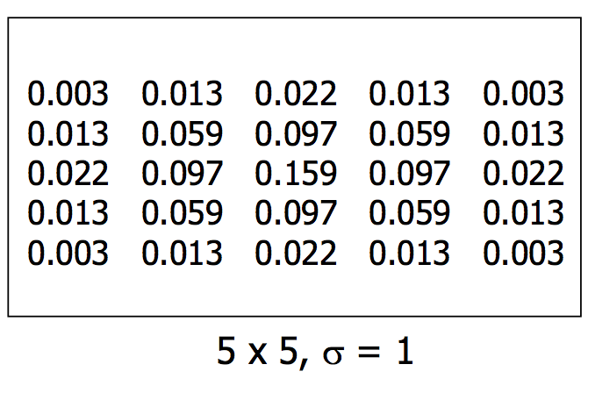
Gaussian Filter
Gaussian = normal distribution function

Slide 29
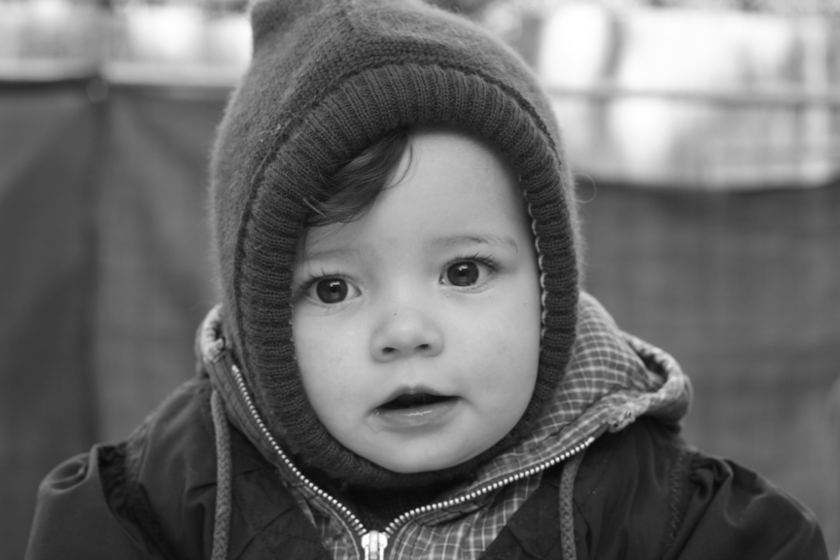
Gaussian filter with different σ
Original
σ = 3
σ = 5
σ = 7

Slide 30
Gaussian Filter
Remove “high-frequency” components from image (low-pass filter)
Images become more smooth
Convolution with self is another Gaussian
So can smooth with small-width kernel, repeat and get same result as larger-width kernel would have.
Convolving two times with kernel width σ is same as convolving once with kernel width σ/2 (Can you proof this?)

Slide 31
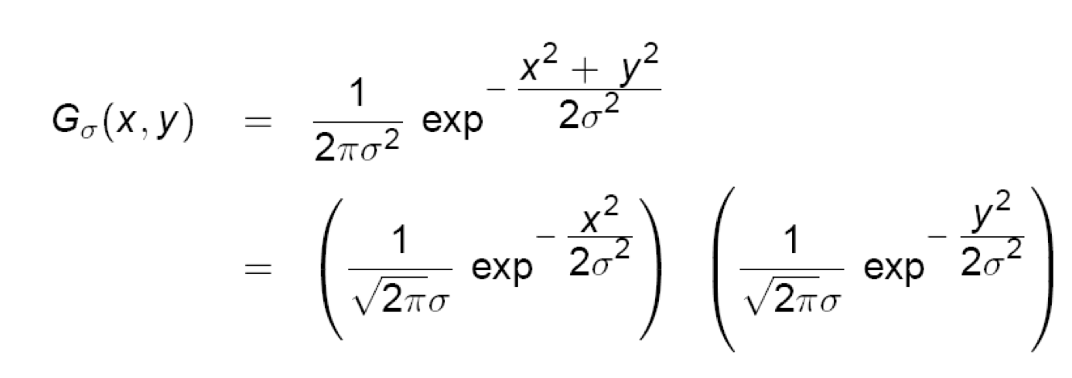
Separability of the Gaussian filter
The 2D Gaussian can be expressed as the product of two functions, one a function of x and the other the function of y.
In this case, the two functions are (identical) 1D Gaussian.

Slide 33
Why is separability useful?
The process of performing a convolution requires K^2 operations per pixel
Suppose v and h are horizontal and vertical kernels.
K = vh^T
2K operations per pixel!

Slide 34
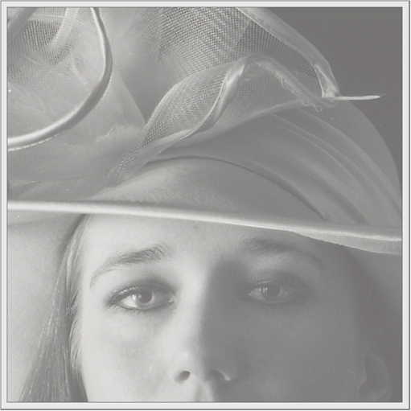
Image Histogram Equalization
We have a low-contrast image:

Slide 35
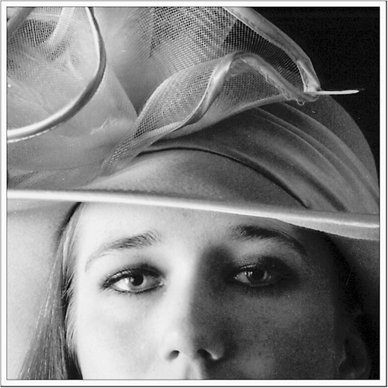
Image Histogram Equalization
We would like to increase the contrast

Slide 36
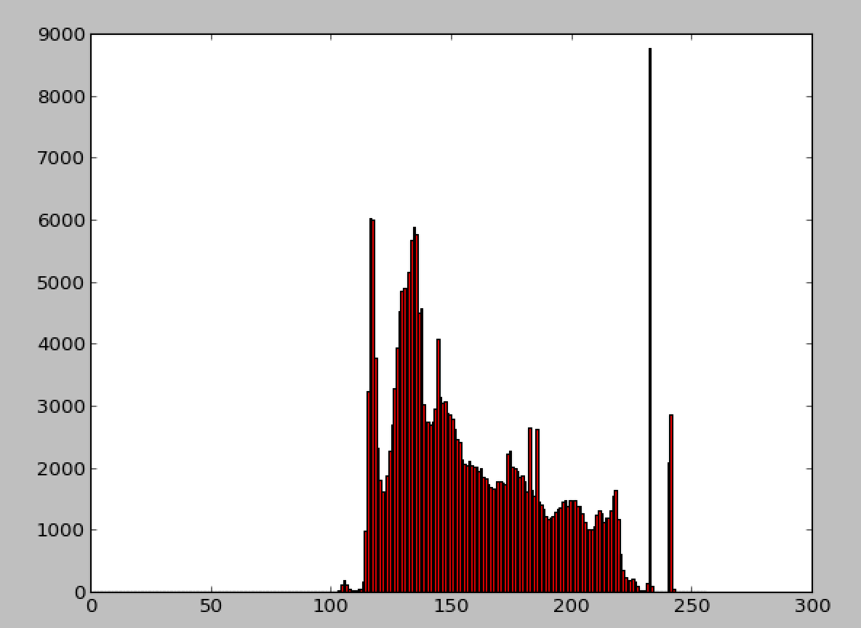
What is a histogram

Slide 37
Image Histogram Equalization
We have a low-contrast image:
Limited image range

Slide 38
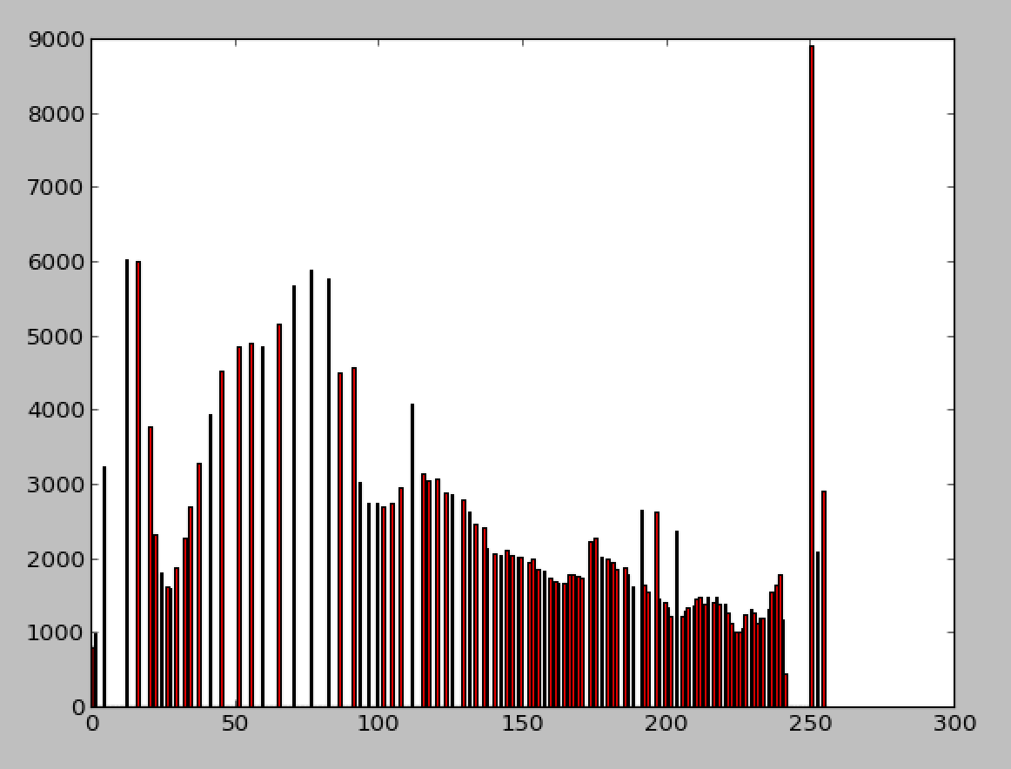
Image Histogram Equalization
What we want is a histogram that covers the whole range of [0,255], but the shape must be preserved!
Ideal histogram

Slide 39
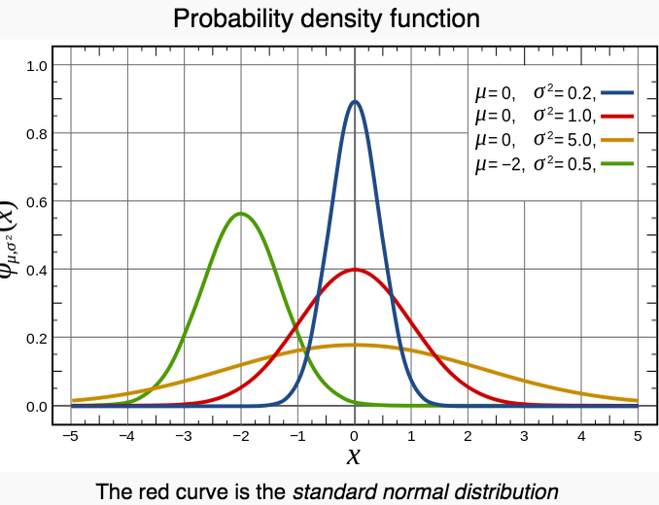
Mini detour of Probability Theory
PDF, density of a continuous random variable, is a function that describes the relative likelihood for this random variable to take on a given value.

Slide 40
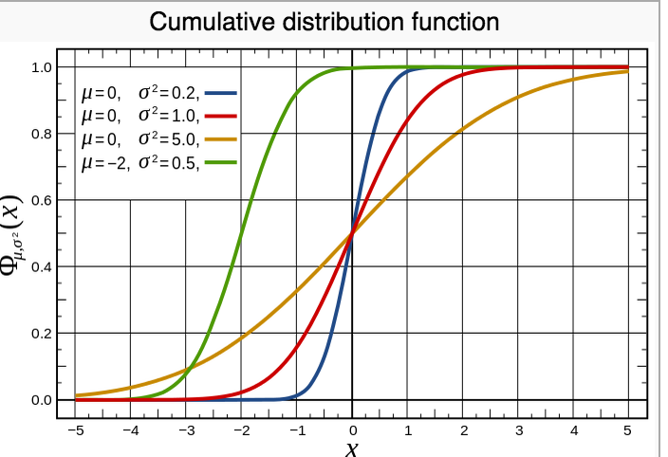
Mini detour of Probability Theory
cumulative distribution function (CDF), describes the probability that a real-valued random variable X with a given probability distribution will be found to have a value less than or equal to x.

Slide 41
How does it work?
Mapping one distribution to another distribution (a wider and more uniform of intensity values) so that the intensity values are spreading over the whole range
The mapping should be the cumulative density function (CDF)

Slide 42
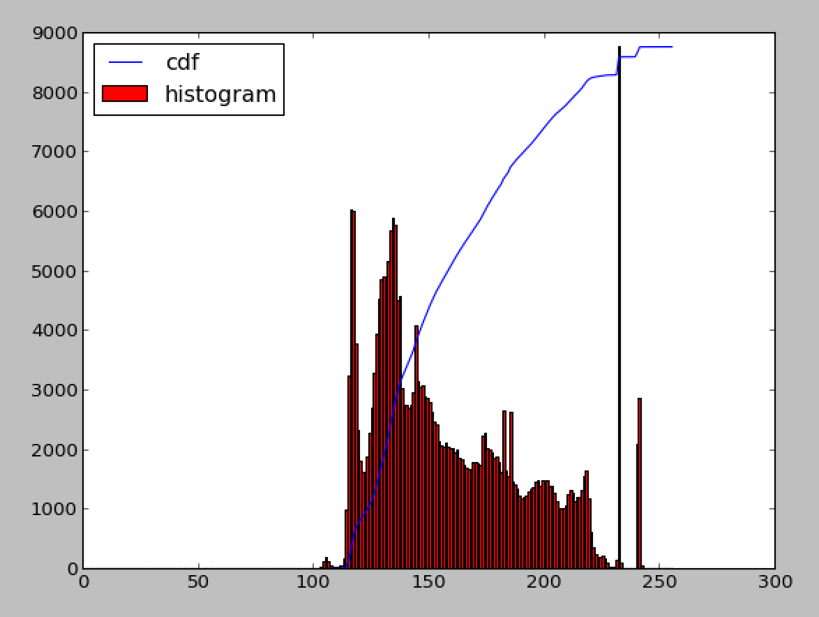
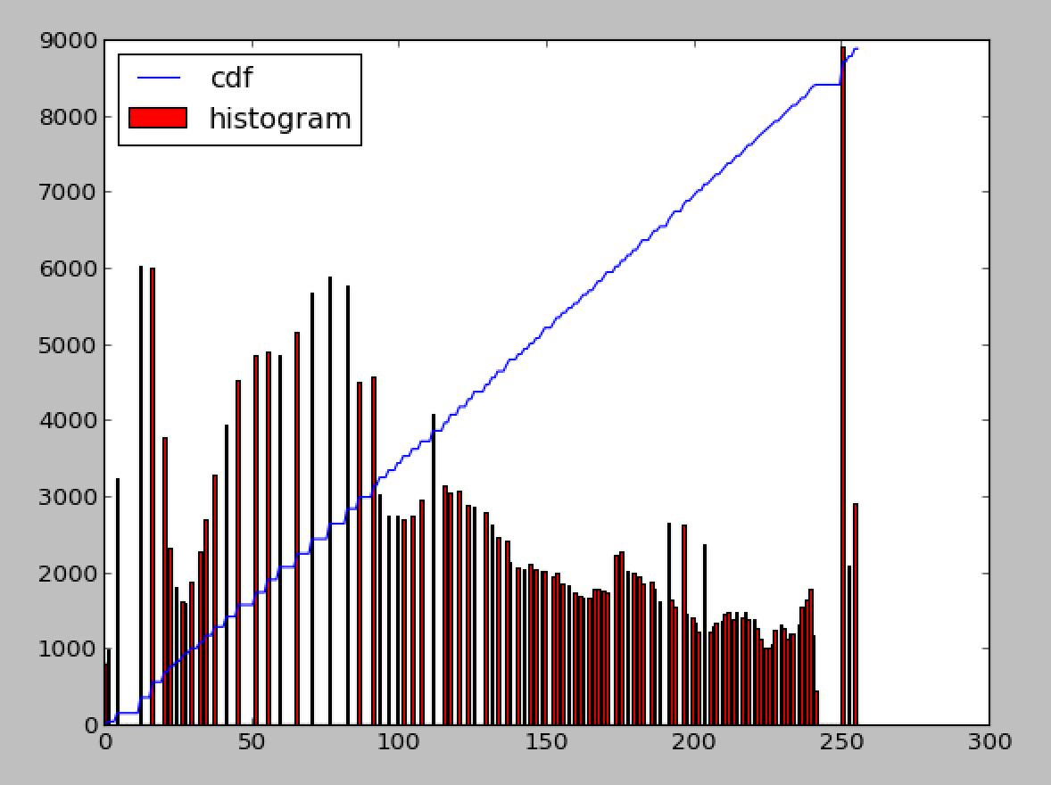
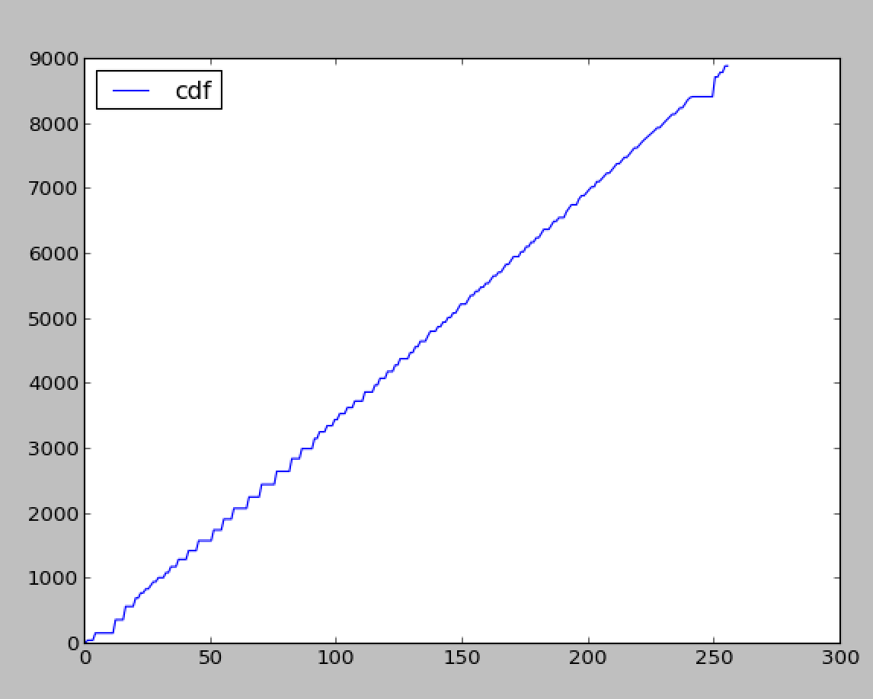
Stretching the CDF
Transform
Before
After

Slide 43
Next class
Bordering effect
Image Derivatives

