Slide 1
CSC 589
Lecture 22 Image Alignment and least square methods
Bei Xiao
American University
April 13

Slide 2
Final project
Due May 4th.
The final websites will be shared among students!!
Presentations will be recorded as a 5 mins you-tube video! We will learn how to do this.
Cite the papers you used and the methods you implemented!! Do not copy codes form the internet!!! If you must copy one or two lines, cite the resources. Plagiarism is easy to detect these days!!
Team members clearly specify who contributed what in your final report.

Slide 3
Reading
Appendix A.2, 6.1

Slide 4
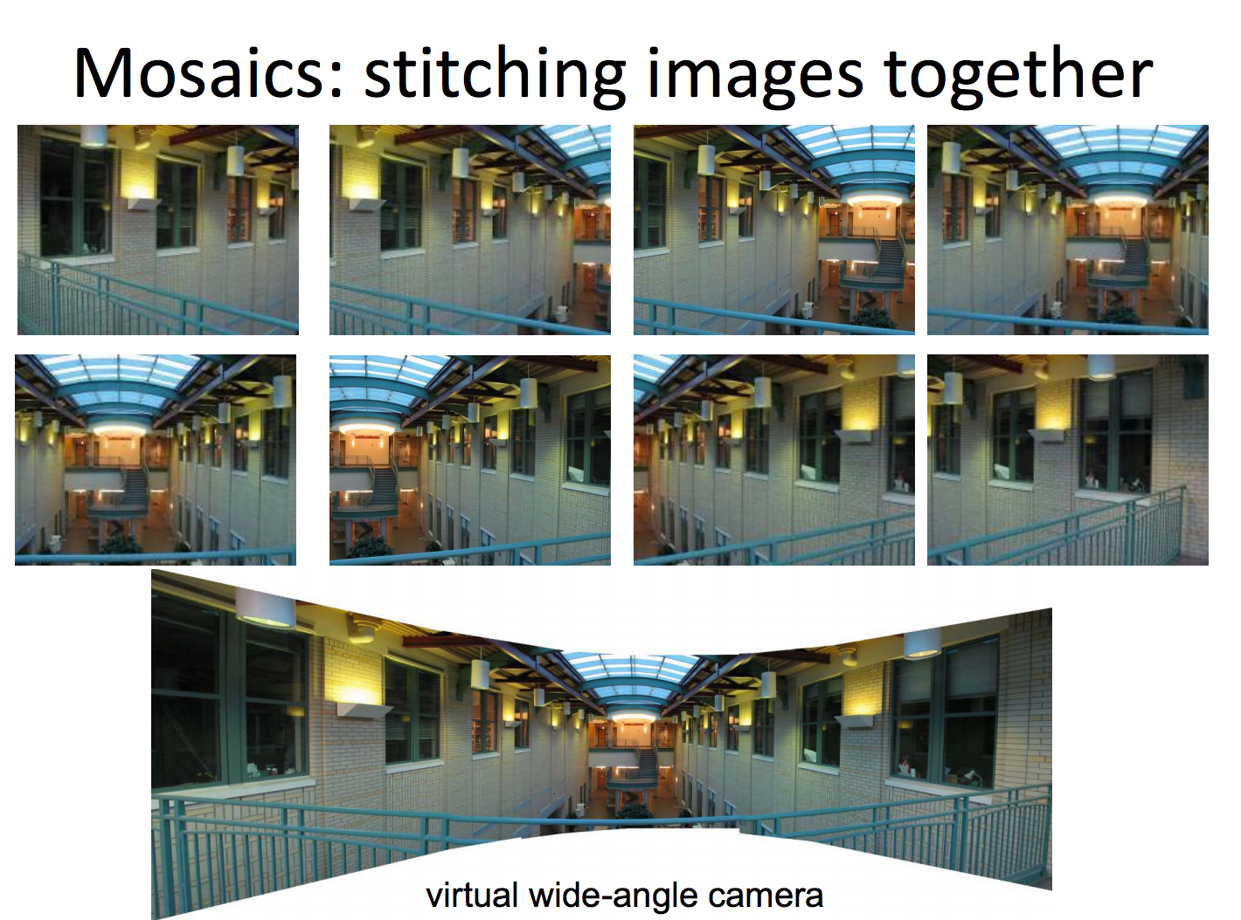

Slide 5
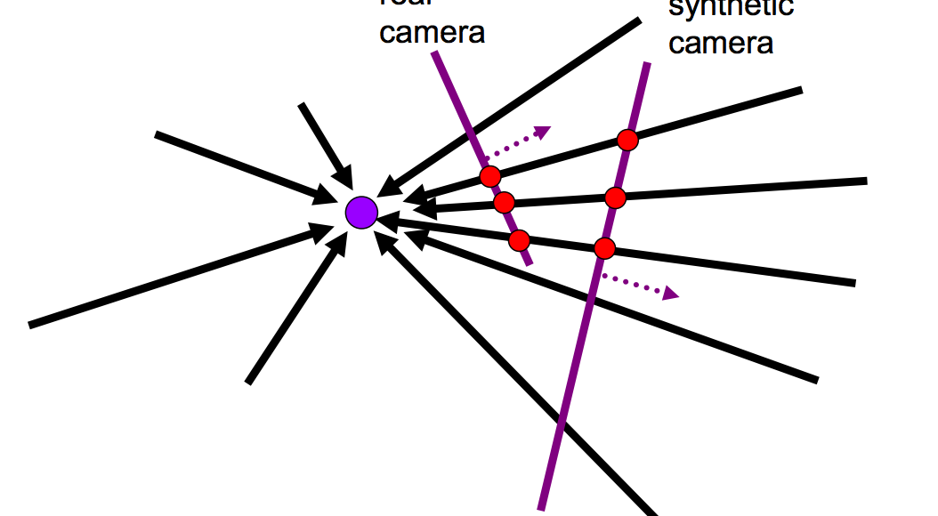
A pencil of rays contains all views
Can generate any synthetic camera view as long as it has the same center of projection

Slide 6
How to do it?
Basic Procedure:
  Take a sequence of images from the same position
  Rotate the camera about its optical center
  Compute transformation between second image and first
  Transform the second image overlap the first
  Blend the two together to create a mosaic
  If there are more images, repeat
But wait, why should this work at all?
  What about 3D geometry of the scenes?
  Why aren’t we use it at all?

Slide 7
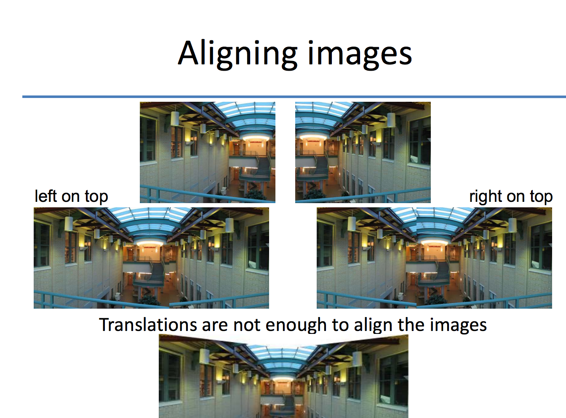
Image Alignment
http://www.inf.ethz.ch/personal/pomarc/courses/CompPhoto/cpv03.pdf

Slide 8
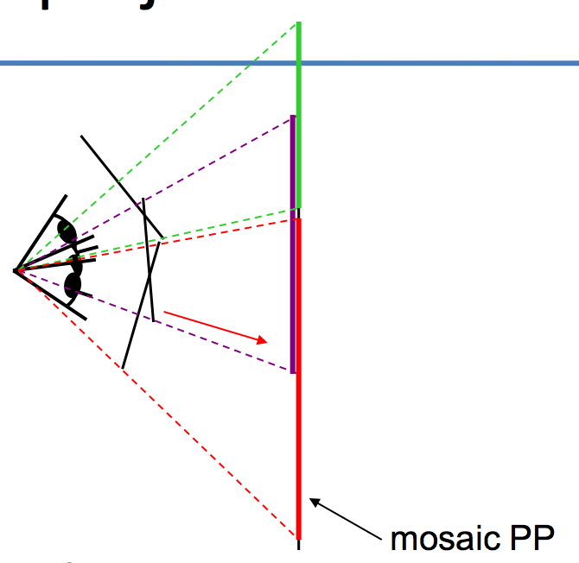
Image reprojection
The mosaic has a natural
Interpretation in 3D
  The images are repojected onto a common plane
  The mosaic is formed on this plane
  Mosaic is a synthetic wide-angel camera

Slide 9
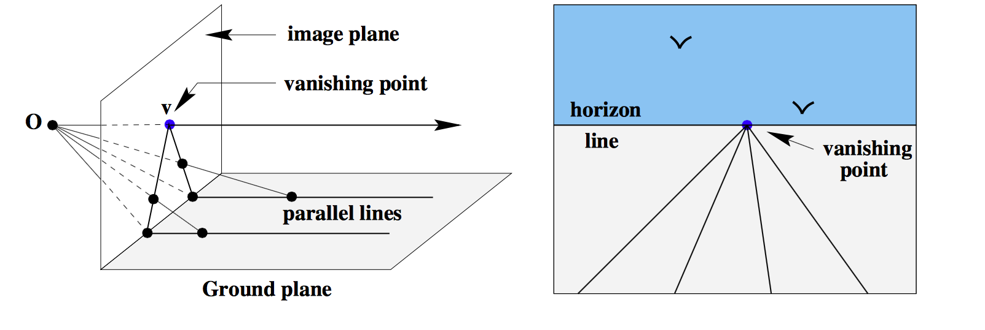

Slide 10
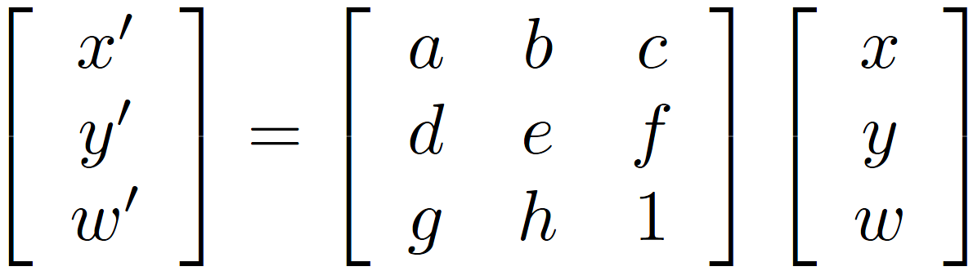
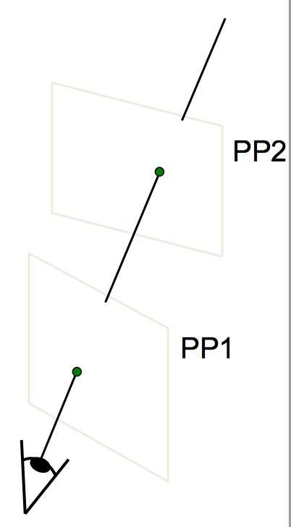
Homography
A projective-mapping between any two PPs with the same center of projection
P’
H
P
Properties of projective transformations:
  Origin does not necessarily map to origin
  Lines map to lines
  Parallel lines do not necessarily remain parallel
  Ratios are not preserved
  Closed under composition

Slide 11
Common problems in vision
Fitting: find the parameters of a model that best fit the data
Alignment: find the parameters of the transformation that best align matched points

Slide 12
Alignment
Alignment: find parameters of model that maps one set of points to another
Typically want to solve for a global transformation that accounts for *most* true correspondences
Difficulties
  Noise (typically 1-3 pixels)
  Outliers (often 50%)

Slide 13
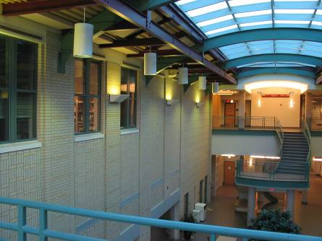
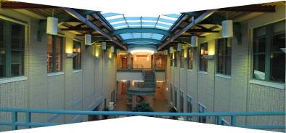
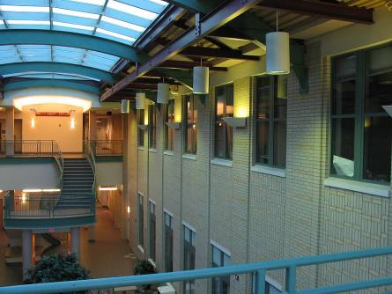
Computing transformations
?

Slide 14
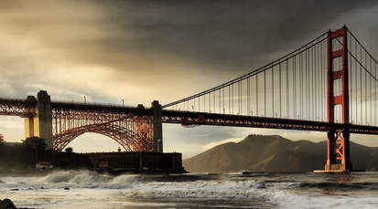


Simple case: translations
How do we solve for
?

Slide 15






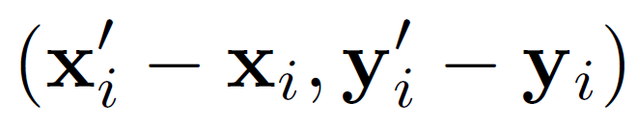
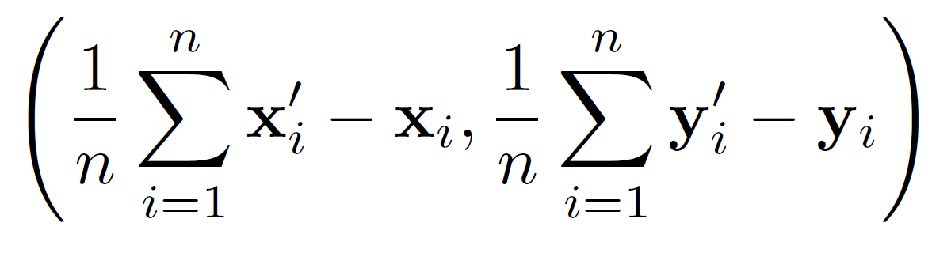
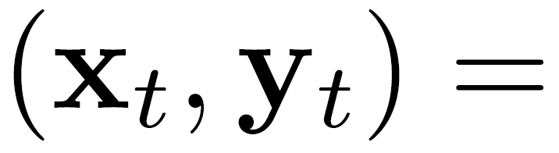
Simple case: translations
Displacement of match i =
Mean displacement =

Slide 16
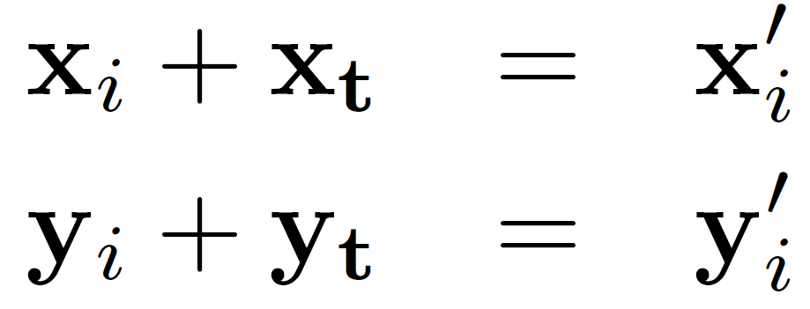
Another view
System of linear equations
  What are the knowns? Unknowns?
  How many unknowns? How many equations (per match)?
Notes:
2 n equations, 2 unknowns

Slide 17
Another view
Problem: more equations than unknowns
  “Overdetermined” system of equations
  We will find the least squares solution
Notes:
The gradient equations at the minimum can be written as (y-Xb) X
A geometrical interpretation of these equations is that the vector of residuals, is orthogonal to the column space of X, since the dot product is equal to zero for any conformal vector, v. This means that is the shortest of all possible vectors , that is, the
variance of the residuals is the minimum possible. This is illustrated at the right.

Slide 18
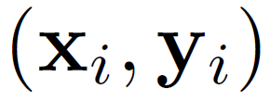
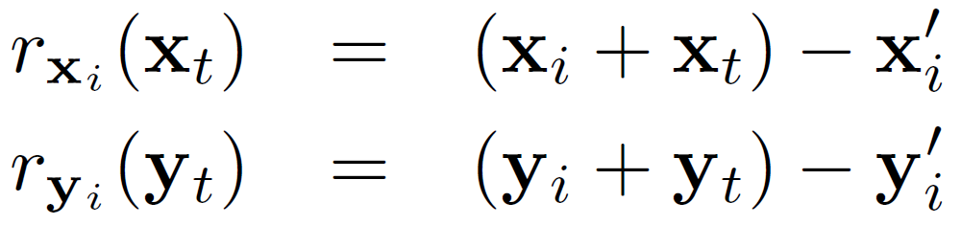
Least squares formulation
For each point
we define the residuals as

Slide 19
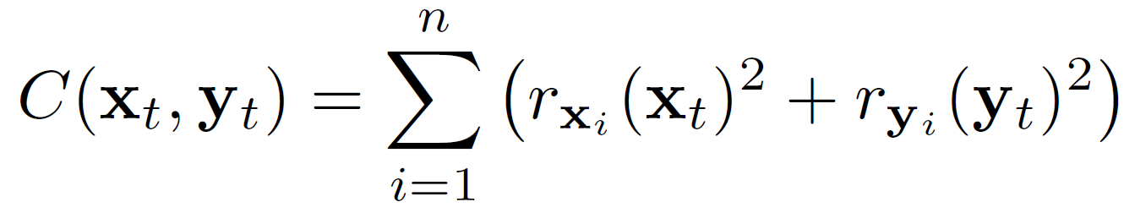
Least squares formulation
Goal: minimize sum of squared residuals
“Least squares” solution
For translations, is equal to mean displacement
Notes:
Can’t just sum the residuals. But sum of squares is used often.

Slide 20
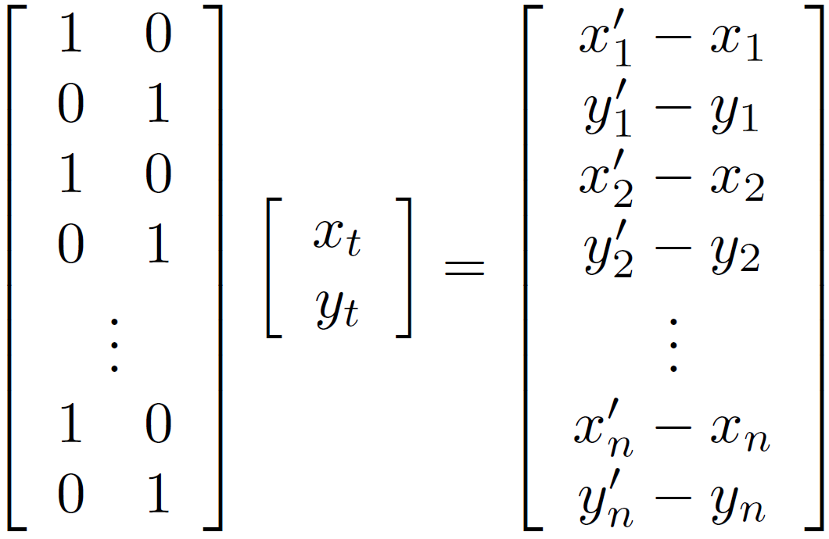




Least squares formulation
Can also write as a matrix equation
2n x 2
2 x 1
2n x 1

Slide 21
Matrix Product mini-review
http://en.wikipedia.org/wiki/Matrix_multiplication
System of linear equations
  http://en.wikipedia.org/wiki/System_of_linear_equations

Slide 22
Matrix manipulations with Numpy
http://www.python-course.eu/matrix_arithmetic.php
https://jameshensman.wordpress.com/2010/06/14/multiple-matrix-multiplication-in-numpy/

Slide 23


Least squares
Find t that minimizes

Slide 24
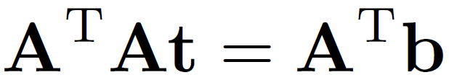
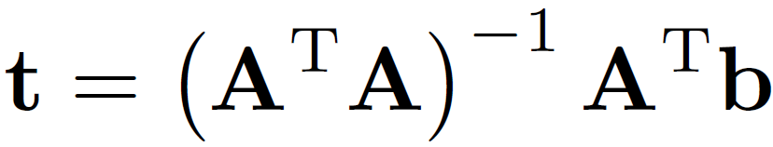
Least squares: find t to minimize
To solve, form the normal equations
    Differentiate and equate to 0 to minimize

Slide 25
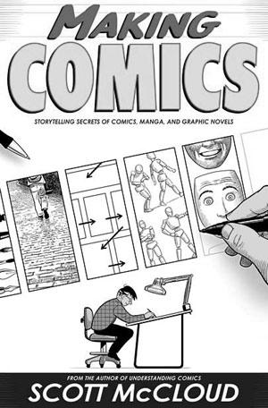
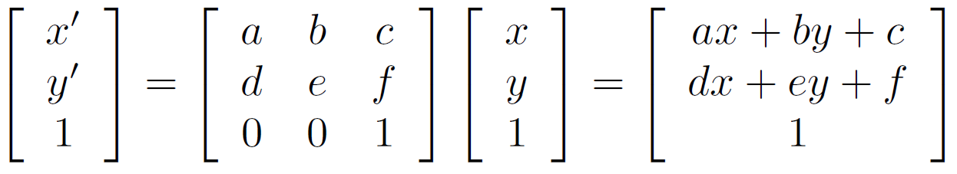

Affine transformations
How many unknowns?
How many equations per match?
How many matches do we need?
Notes:
6. 2. 3 pairss

Slide 26
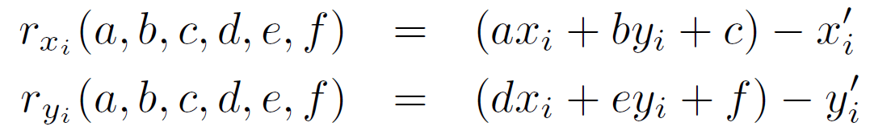

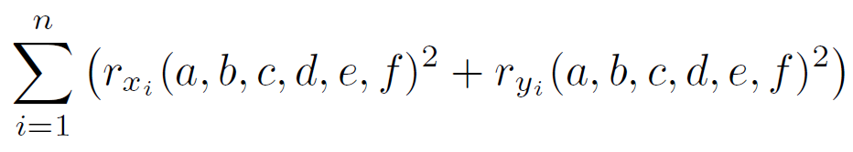
Affine transformations
Residuals:
Cost function:

Slide 27
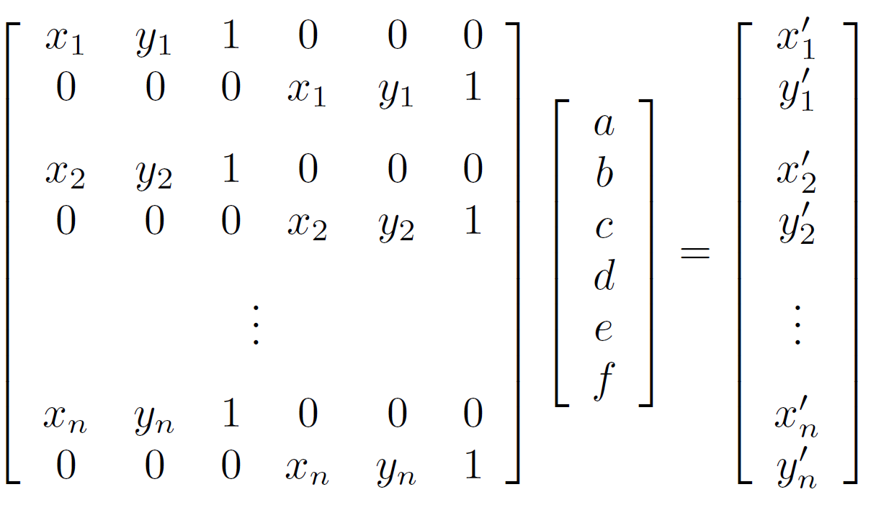
Affine transformations
Matrix form
2n x 6
6 x 1
2n x 1

Slide 28
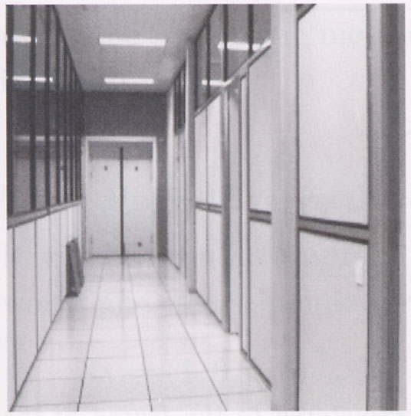
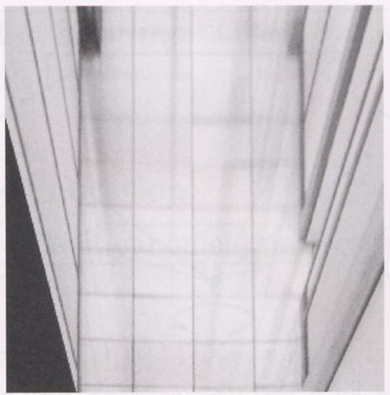
Homographies
p’
p
To unwarp (rectify) an image
  solve for homography H given p and p’
  solve equations of the form: p’ = Hp

Slide 29
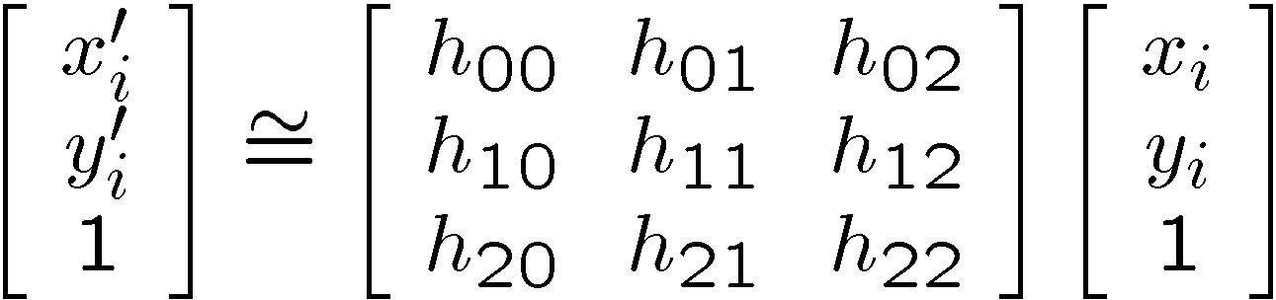
Alternate formulation for homographies
where the length of the vector [h₀₀ h₀₁ … h₂₂] is 1

Slide 30
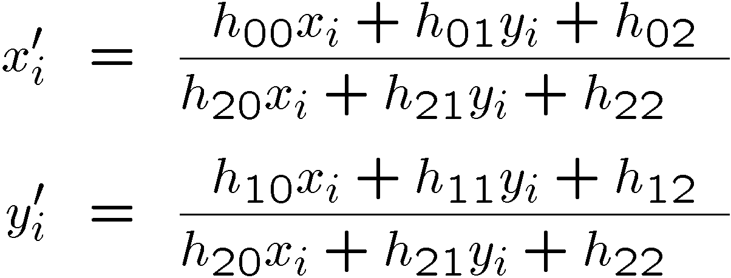
Solving for homographies
Linear or non-linear?

Slide 31
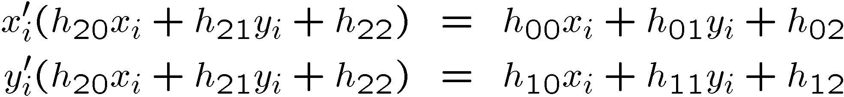
Solving for homographies
Notes:
X’ is not linear in x and y. But constraints on the h values are linear.

Slide 32
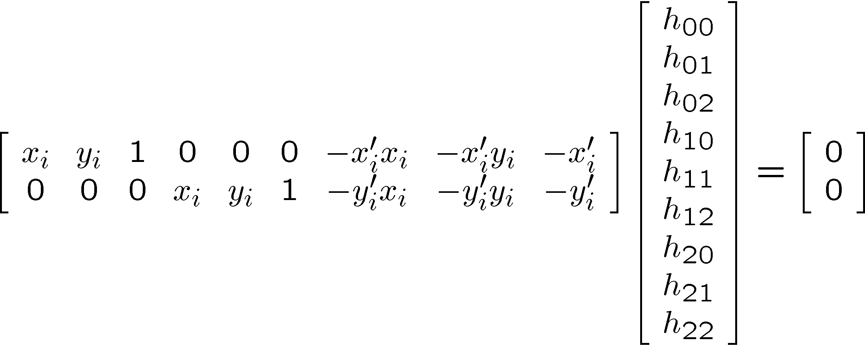
Solving for homographies
Notes:
Linear set of equations in h. Need 4 points if you add the constraint of unit norm,

Slide 33
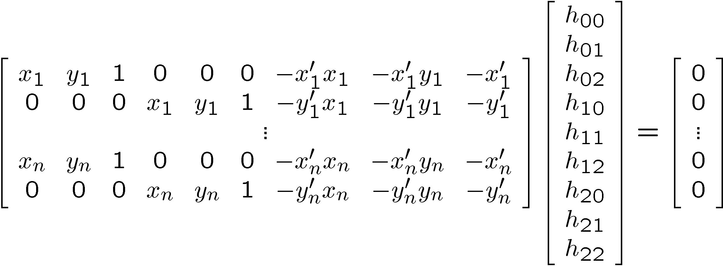





Solving for homographies
2n × 9
9
2n
Defines a least squares problem:
  Since is only defined up to scale, solve for unit vector

Slide 34
Homographies
p’
p
To unwarp (rectify) an image
  solve for homography H given p and p’
  solve equations of the form: p’ = Hp
    linear in unknowns: coefficients of H
    H is defined up to an arbitrary scale factor
    how many points are necessary to solve for H?

Slide 35
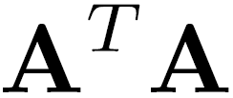
Solving for homographies
2n × 9
9
2n
Defines a least squares problem:
  Since is only defined up to scale, solve for unit vector
  Solution: = eigenvector of with smallest eigenvalue
  Works with 4 or more points

Slide 36
Recap: Two Common Optimization Problems
Problem statement
Solution
(matlab)
Problem statement
Solution

Slide 37
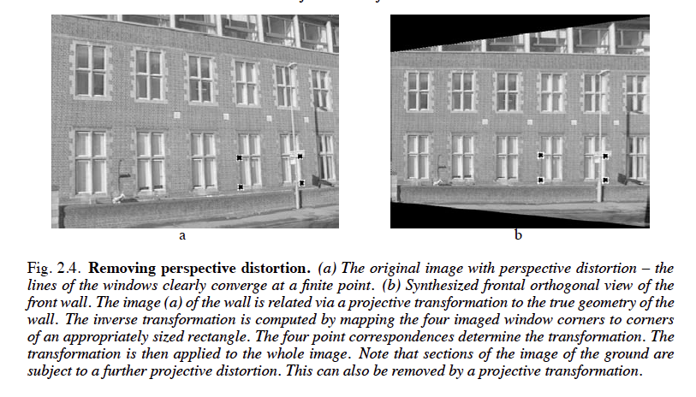

Slide 38
Least squares: linear regression
(y_{i}, x_{i})
y = mx + b

Slide 39
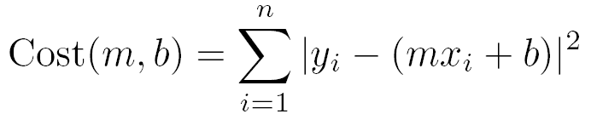
Linear regression
residual error

Slide 40
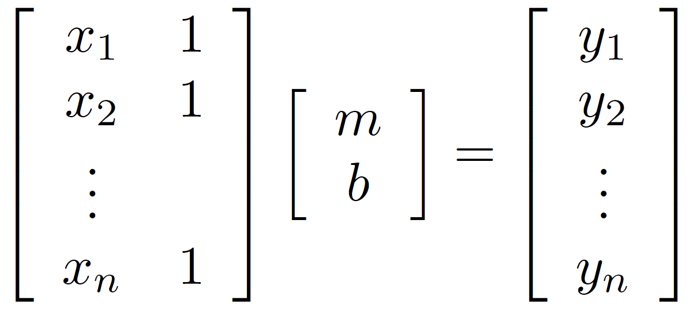
Linear regression

Slide 41
Image Alignment Algorithm
Given images A and B
Compute image features for A and B
Match features between A and B
Compute homography between A and B using least squares on set of matches
What could go wrong?

Slide 42
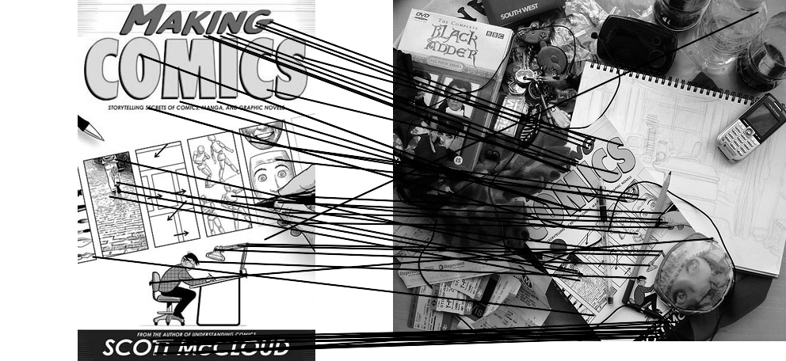
Outliers
outliers
inliers

Slide 43
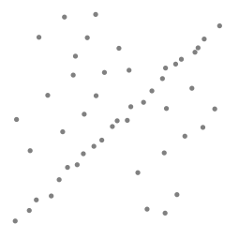
Robustness
Problem: Fit a line to these datapoints
Least squares fit

Slide 44
What can we do?
Suggestions?

Slide 45
Idea
Given a hypothesized line
Count the number of points that “agree” with the line
  “Agree” = within a small distance of the line
  I.e., the inliers to that line
For all possible lines, select the one with the largest number of inliers

Slide 46
Counting inliers

Slide 47
Counting inliers
Inliers: 3

Slide 48
Counting inliers
Inliers: 20

