Slide 1
CSC589 Introduction to Computer Vision
Lecture 6
Image Derivative, Image-Denoising
Bei Xiao

Slide 2
Last lecture
Linear Algebra
Matrix computation in Python

Slide 3
Today’s lecture
More on Image derivatives
Quiz
Image De-noising
Median Filter
Introduction to Frequency analysis
Homework is due today! Please follow hand-in instructions. Be sure to include your write-up document!!

Slide 4
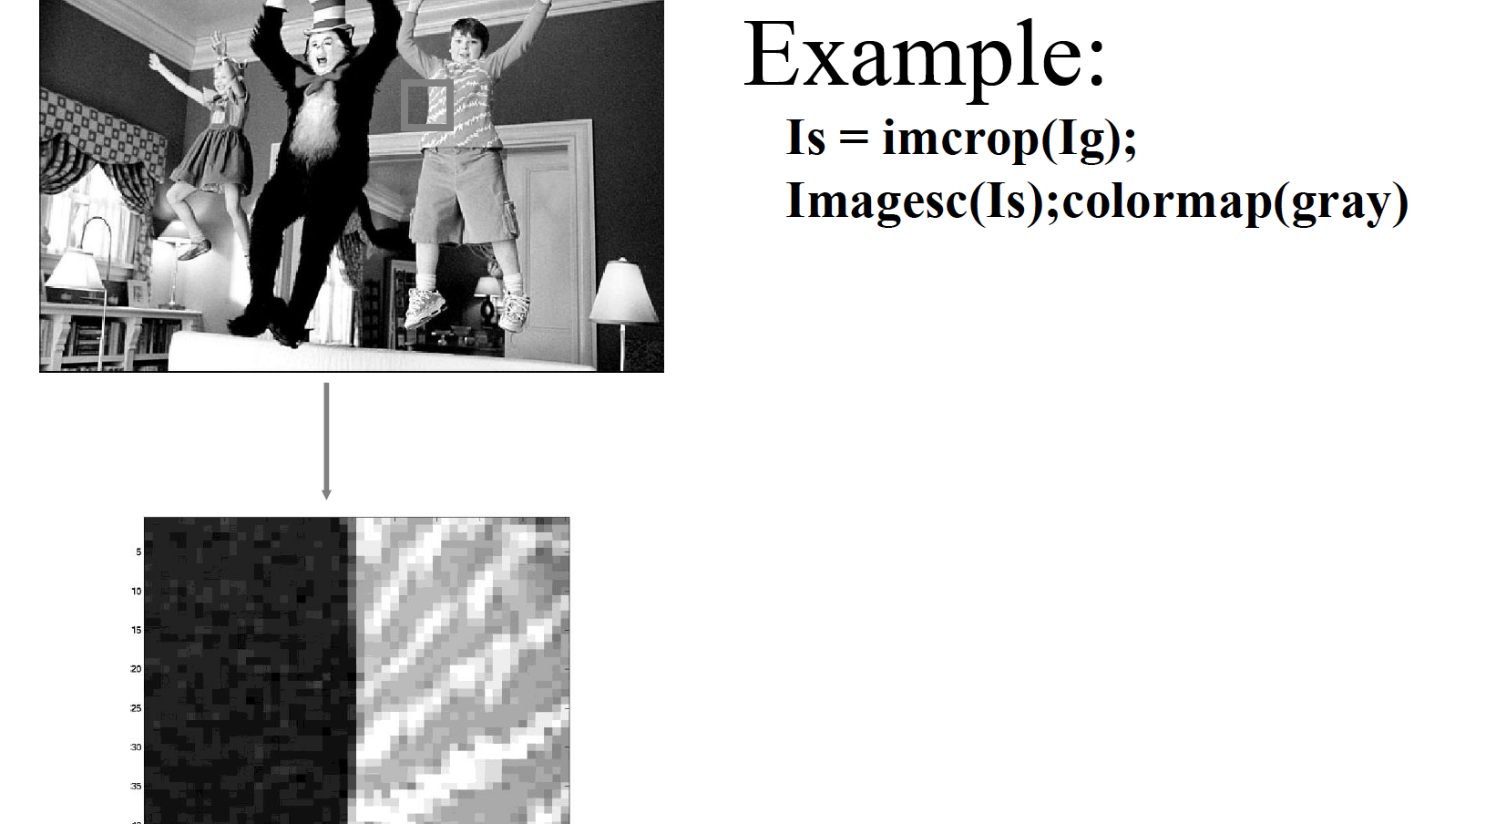
Compute Image Gradient
The first order derivative of Image I in x, and in y direction

Slide 5
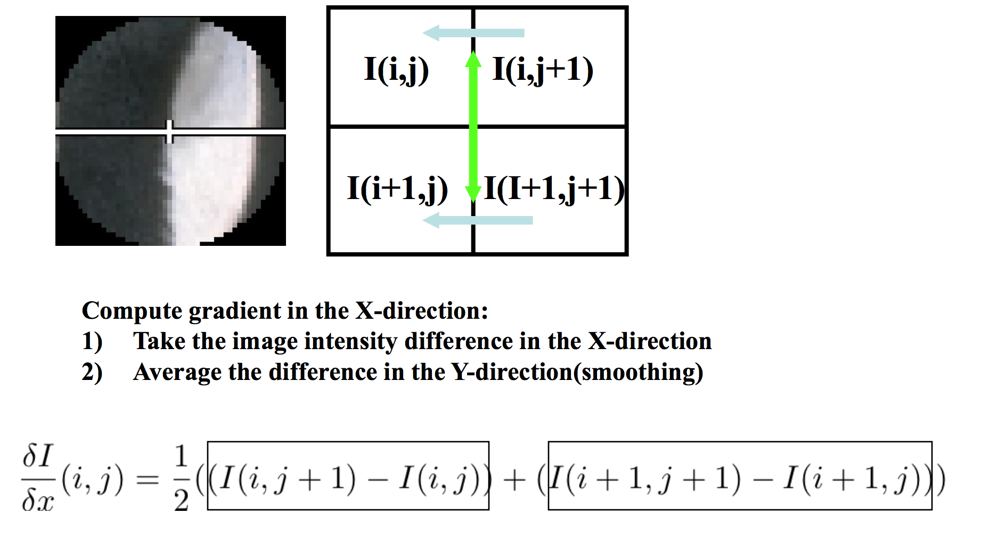
Compute gradient: first order derivatives
Slide source: Jianbo Shi

Slide 6
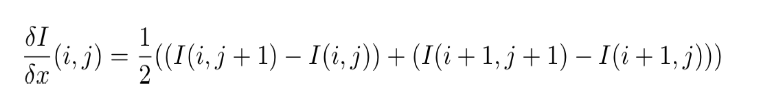
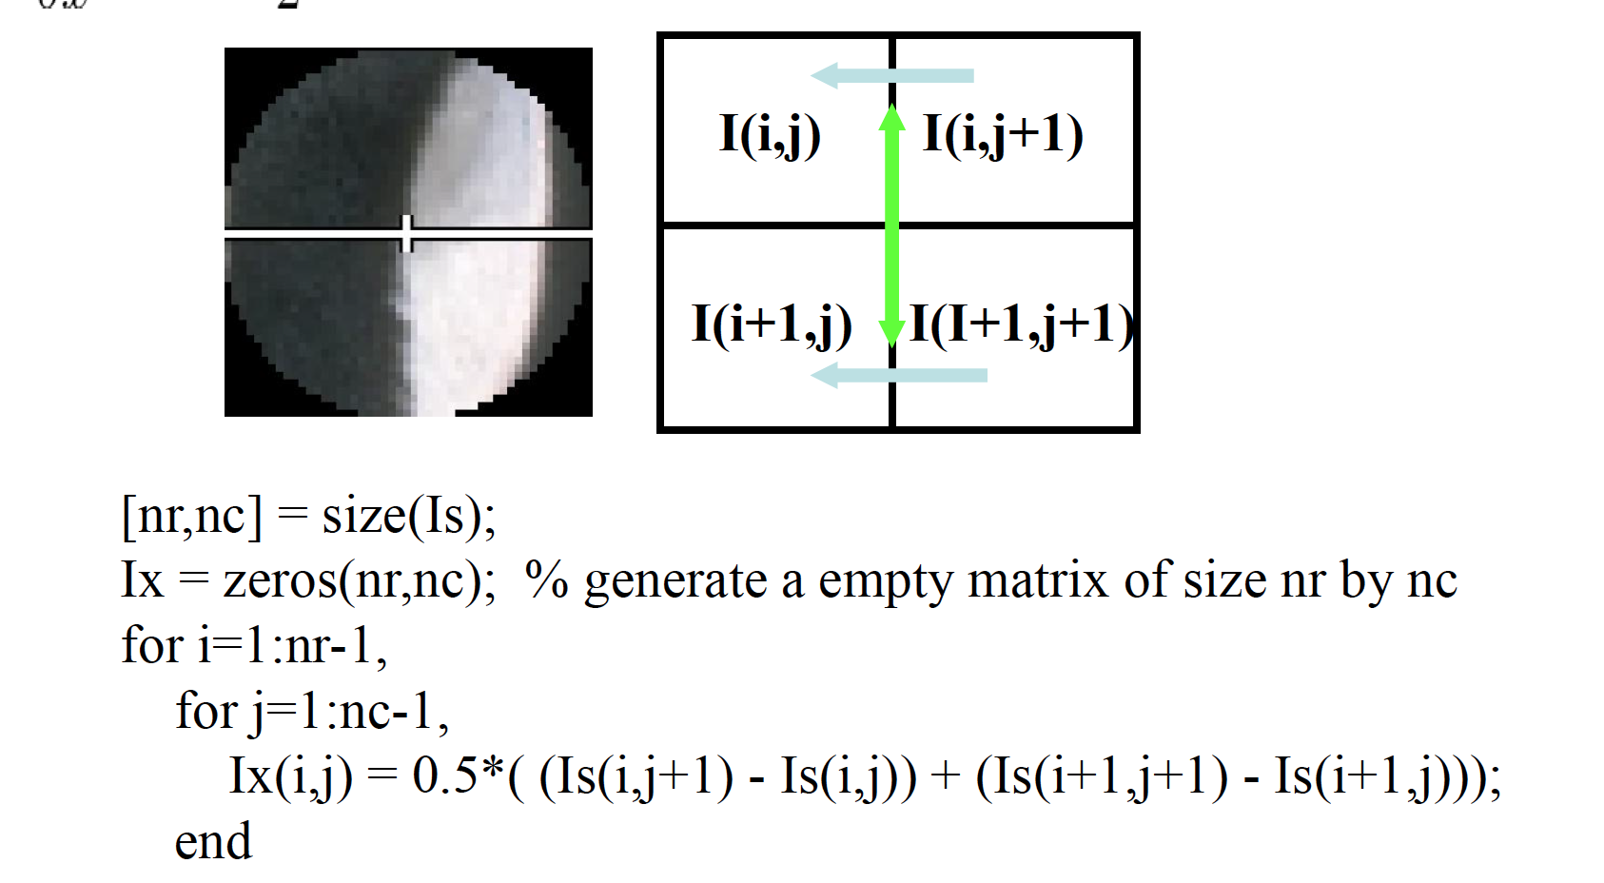
Compute gradient: first order derivatives
Slide source: Jianbo Shi

Slide 7
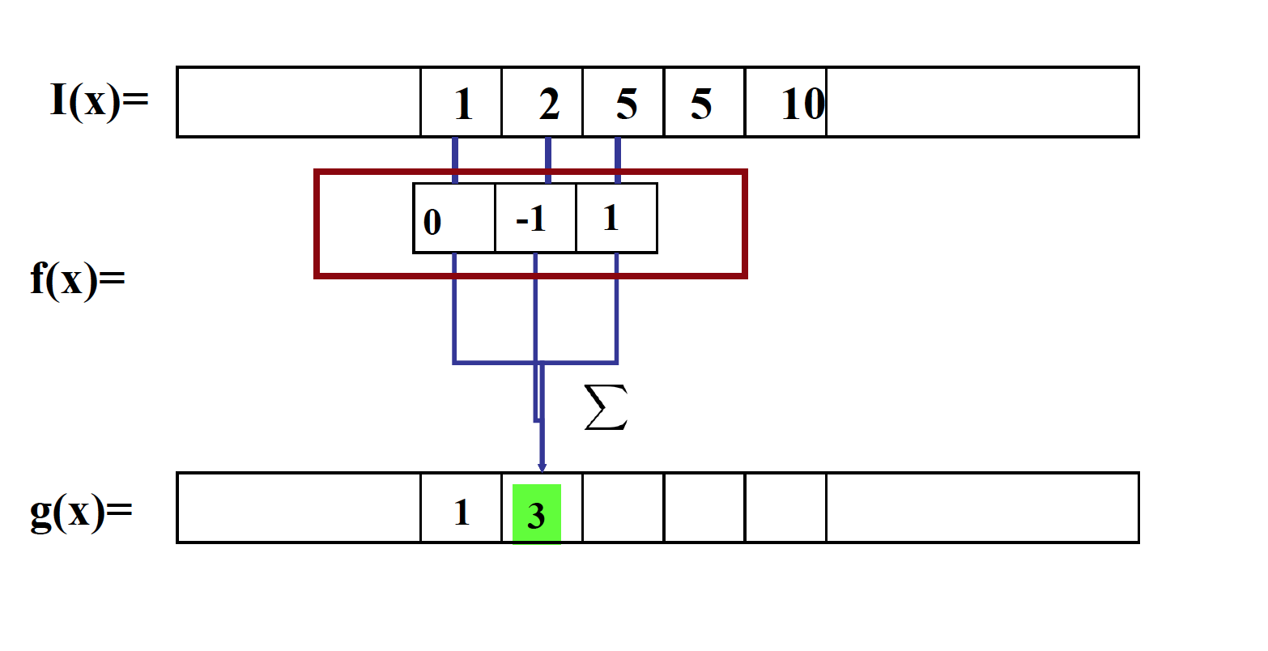
Compute gradient as convolution operation!

Slide 8
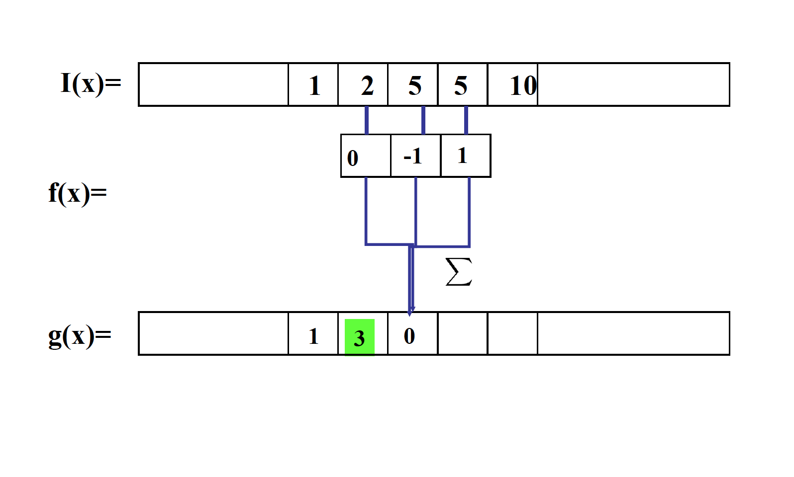
Compute gradient as convolution operation!

Slide 9
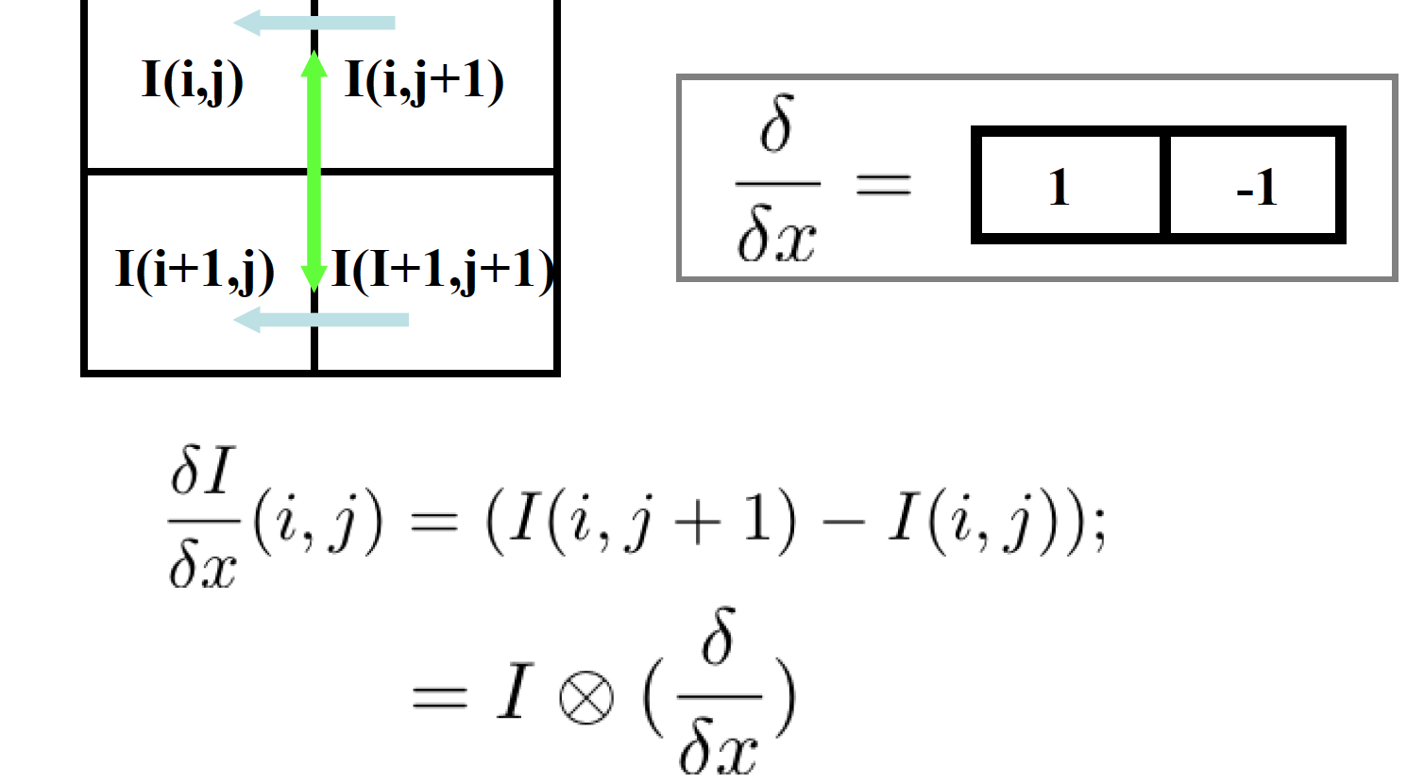
Compute gradient: first order derivatives

Slide 10
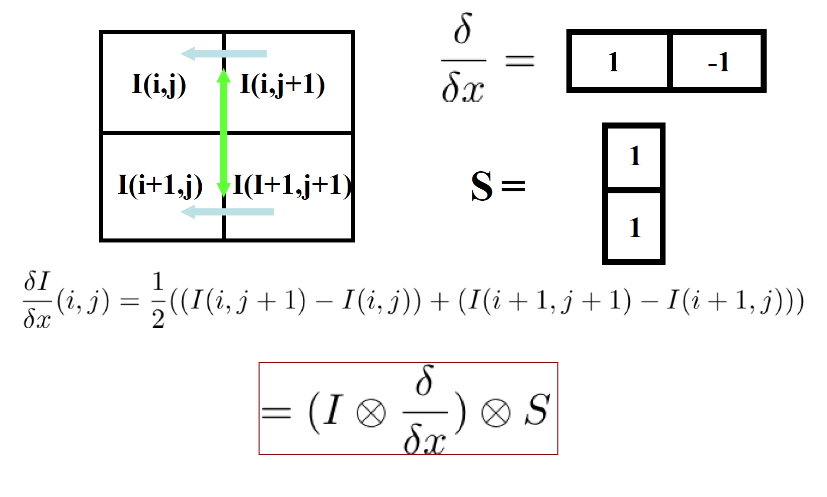
Compute gradient: first order derivatives

Slide 11

Example

Slide 12
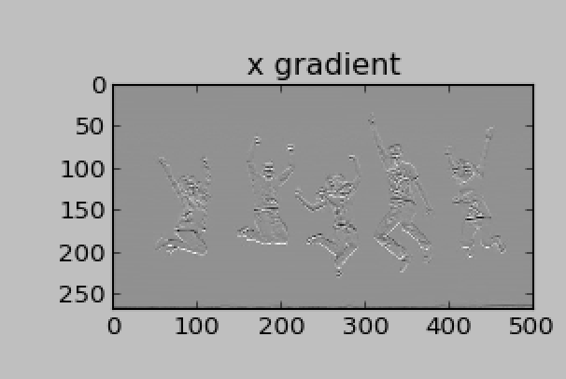
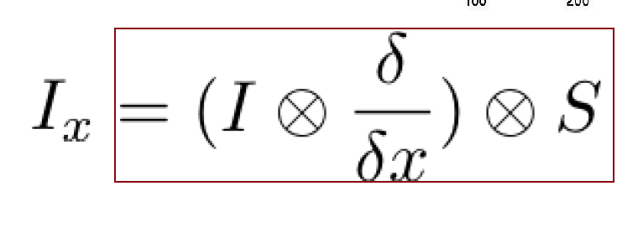
Usage in Python
s1 = np.array([1,1])
dx = np.array([1,-1])
dy = np.array([1,-1])
x = ndimage.convolve1d(l,dx,axis= 0)
gx_I = ndimage.convolve(x,s)

Slide 13
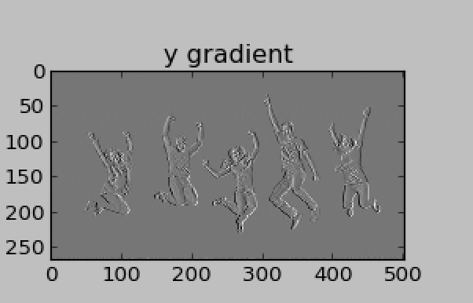
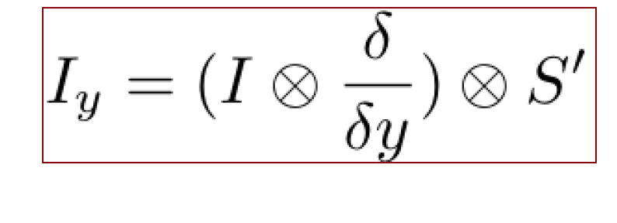
Usage in Python
s1 = np.array([1,1])
dx = np.array([1,-1])
dy = np.array([1,-1])
y = ndimage.convolve1d(l,dx,axis= 1)
gy_I = ndimage.convolve(y,s)
Or : gx_I,gy_I = np.gradient(l)[:2]

Slide 14
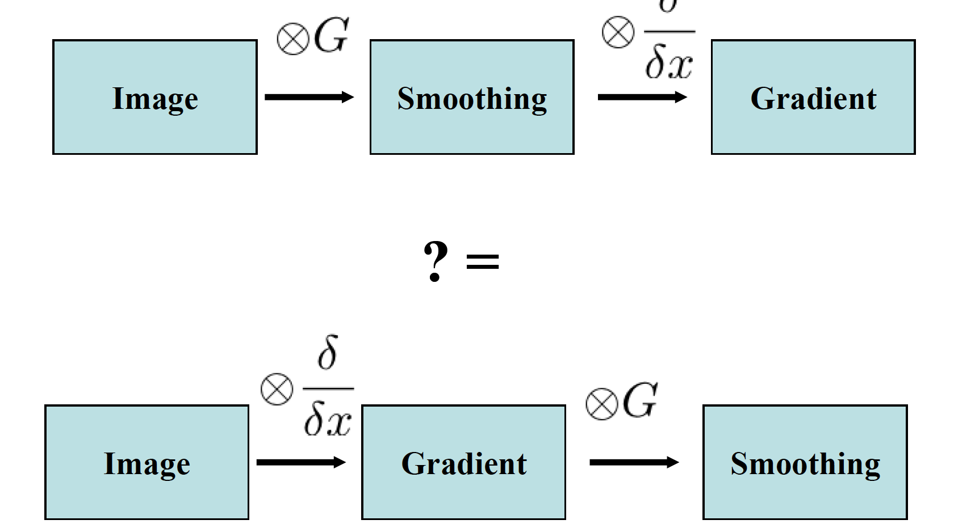
We can switch the order of smoothing and gradient

Slide 15
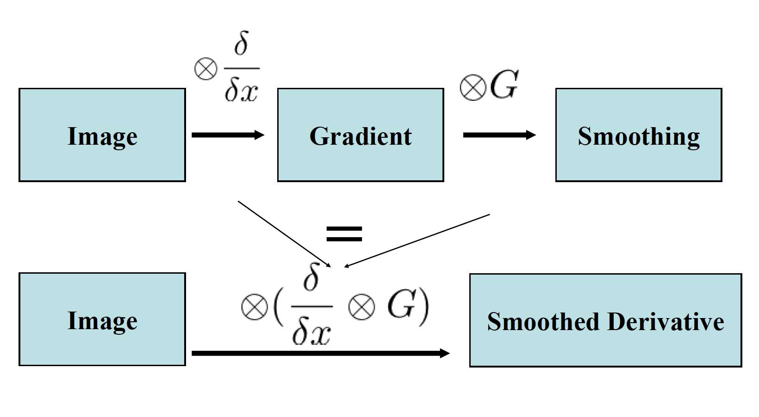
We can simplify even more

Slide 16
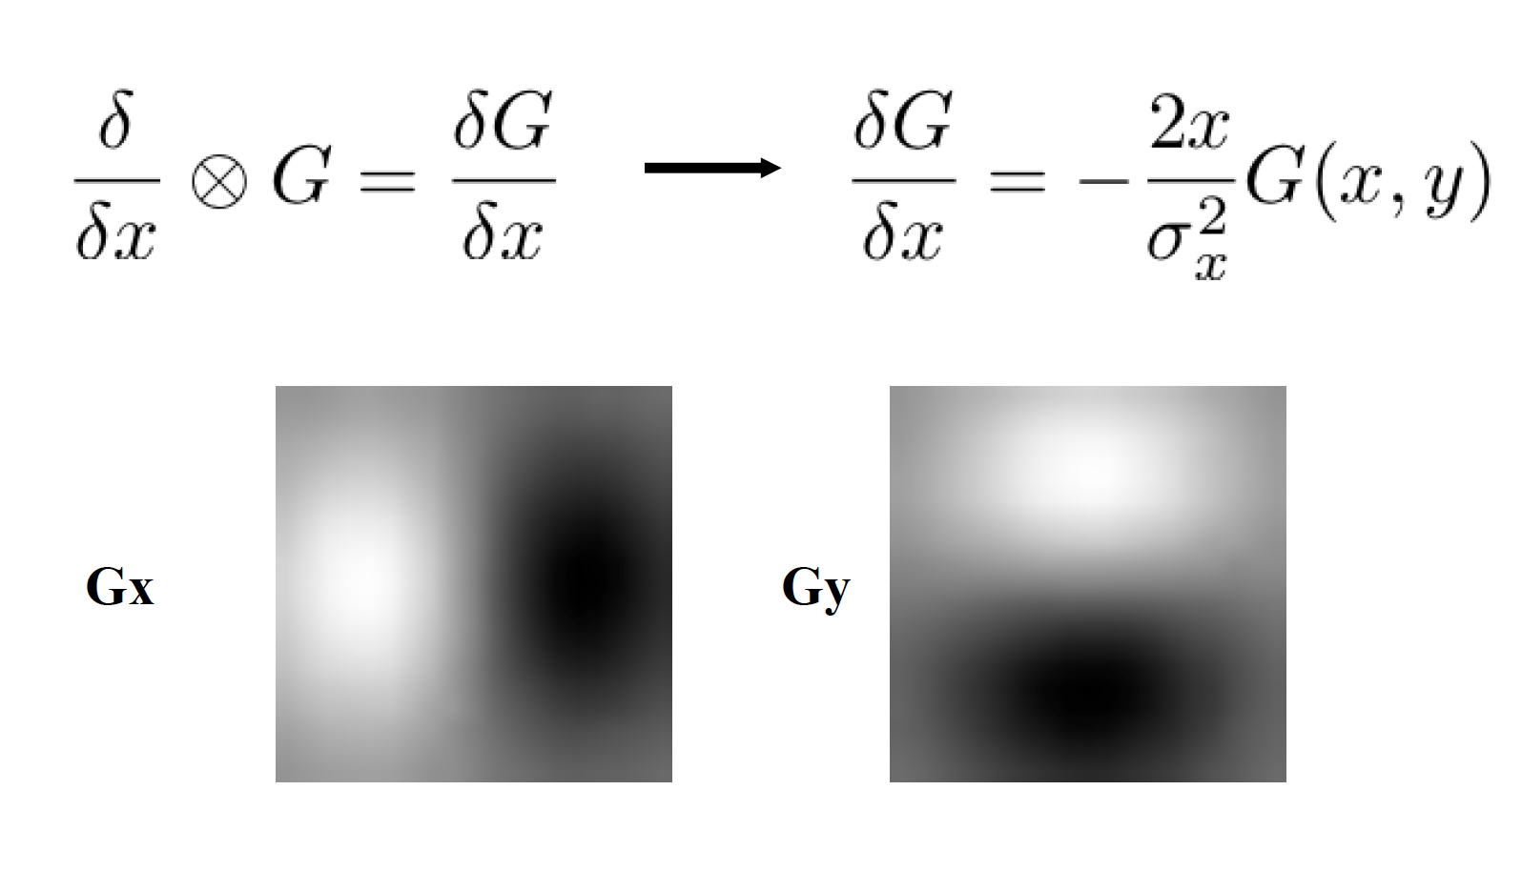
Smoothed derivative filter
Notes:
http://docs.scipy.org/doc/numpy/reference/generated/numpy.gradient.html

Slide 17
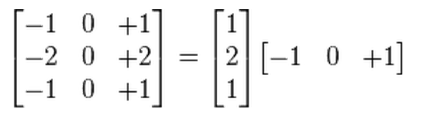
Sobel Filter
Product of averaging and gradient.
An cross product of two 1 d filter, Gaussian and gradient

Slide 18
Review Questions (please turn in your answer)
  Write down a 3×3 filter that returns a positive value if the average value of the 4-adjacent neighbors is less than the center and a negative value otherwise. Hint: don’t forget the normalization factor.
  Write down a filter that will compute the gradient in the x-direction
  gradx(y,x) = im(y,x+1)-im(y,x) for each x,y
Notes:
[0 -1/4 0;
-1/4 1 -1/4;
0 -1/4 0]
[0 -1 1]

Slide 19
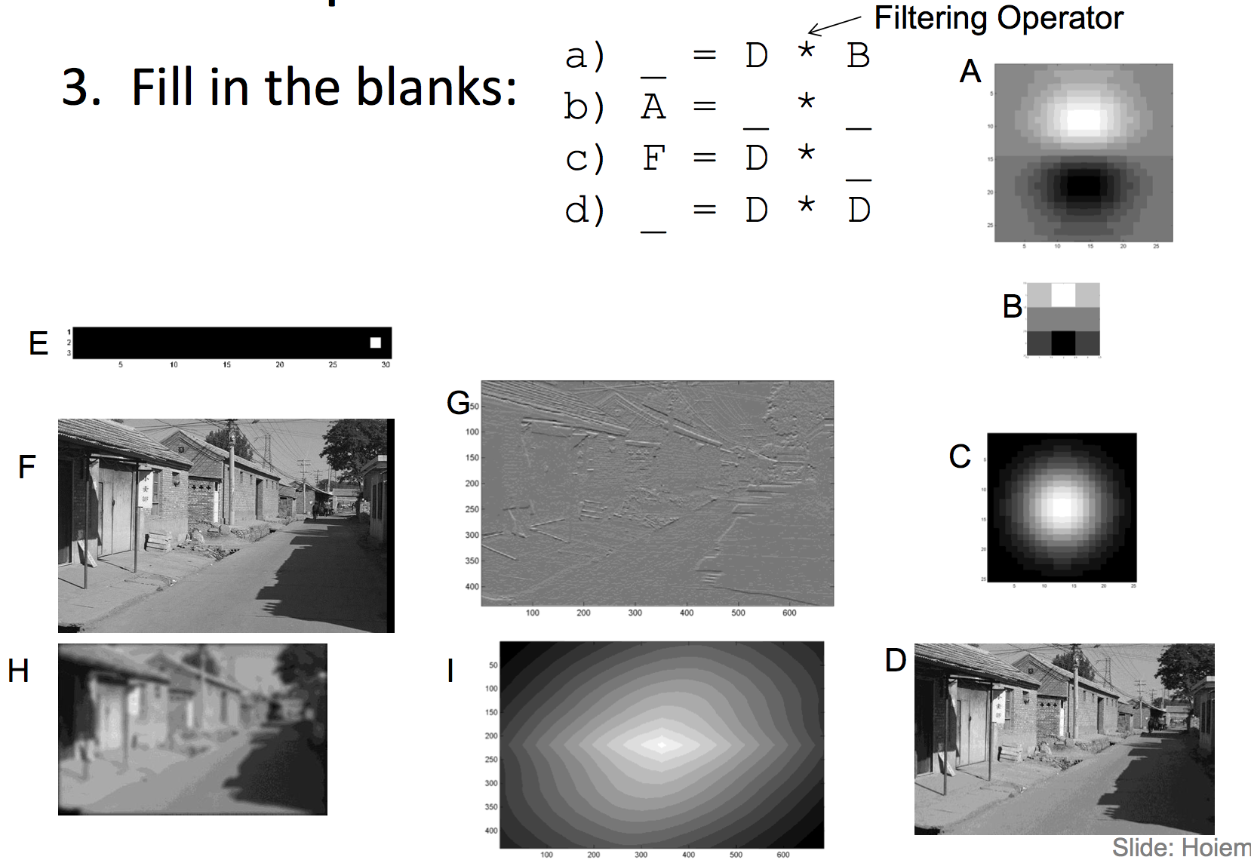
Review Questions (please turn in your answer)
Notes:
a) G = D * B
b) A = B * C
c) F = D * E
d) I = D * D

Slide 20
Image Noise
Types of noises in images
  Gaussian noise: Poor illumination, additive, independent for each pixel
  Salt and Pepper: Dead pixels on LCD monitor
  Film grain, poison distribution.

Slide 21
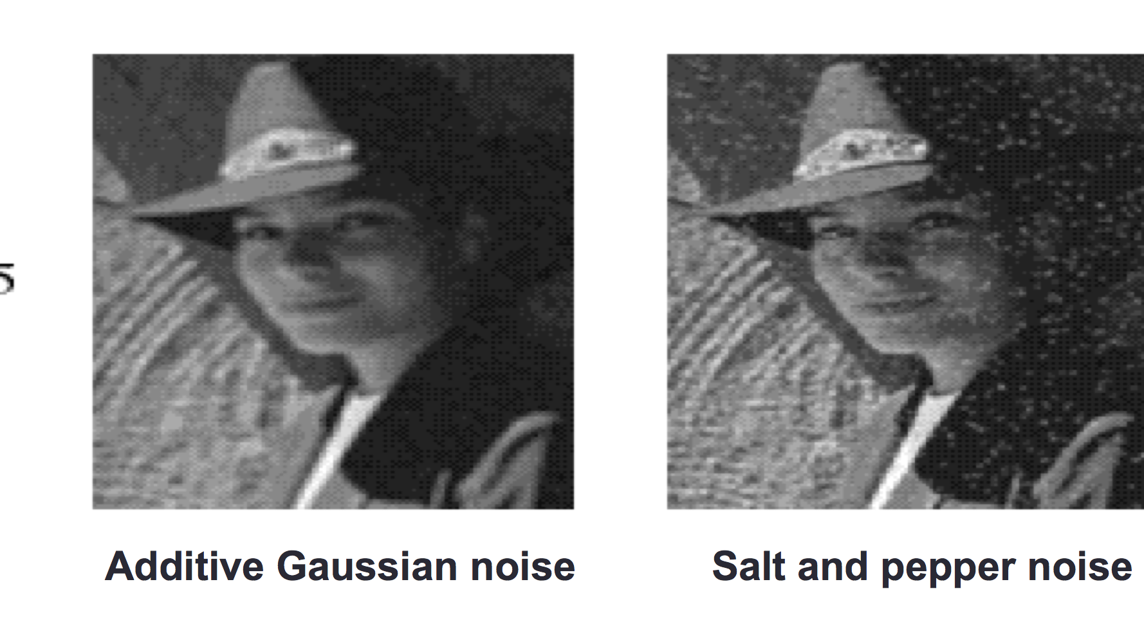
Image Noise

Slide 22
Image Noise
Add Gaussian noise: Image + noise
In Python:
  noisy = l + 0.4 * l.std() *np.random.random(l.shape)
Salt and Pepper noise
Randomly replace pixels with white and black values
In Python:
  num_salt = np.ceil(0.05 * l.size * 0.5)
  coords = [np.random.randint(0, i - 1, int(num_salt))
  for i in l.shape]

Slide 23
Median Filter
X = [2 80 6 3]
The median filter has a window size 3
The median filtered out signal y will be:
Y[1] = Median [2 2 80] = 2
Y[2] = Median [2 80 6] = 6
Y[3] = Median[80 6 3] = 6
Y[3] = Median [6 3 3 ] = 3
Notice the repeating of the first element
Selecting one pixel as a time; Not as efficient as Gaussian Filter

Slide 24
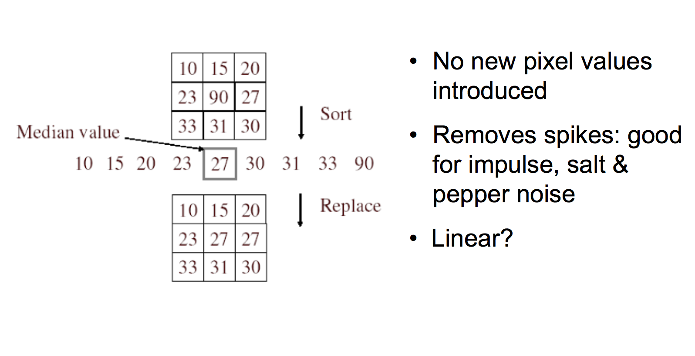
Median Filter

Slide 25
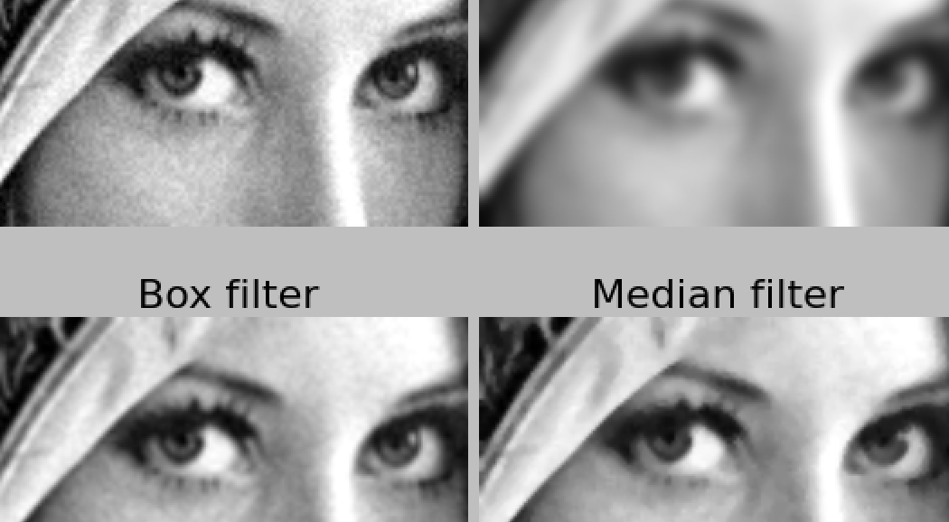
Comparison of the de-noisy results
Noisy Image
Gaussian filter

Slide 26
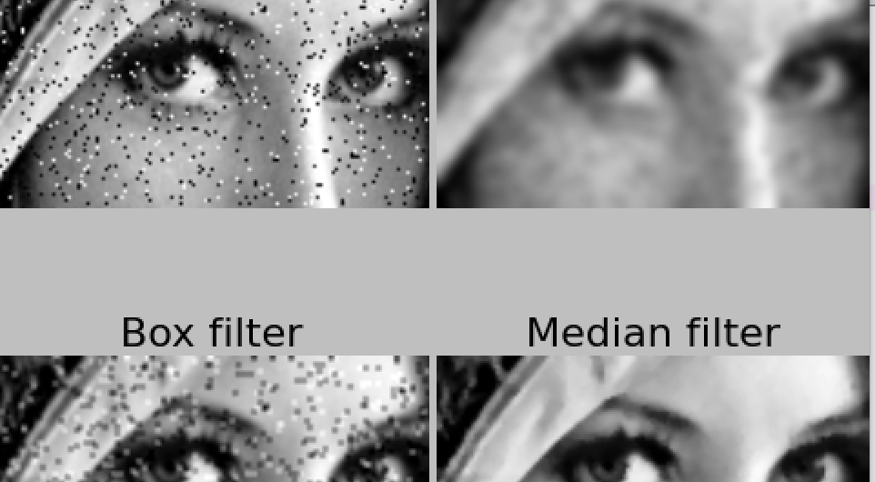
Comparison of the de-noisy results
Noisy Image
Gaussian filter

Slide 27
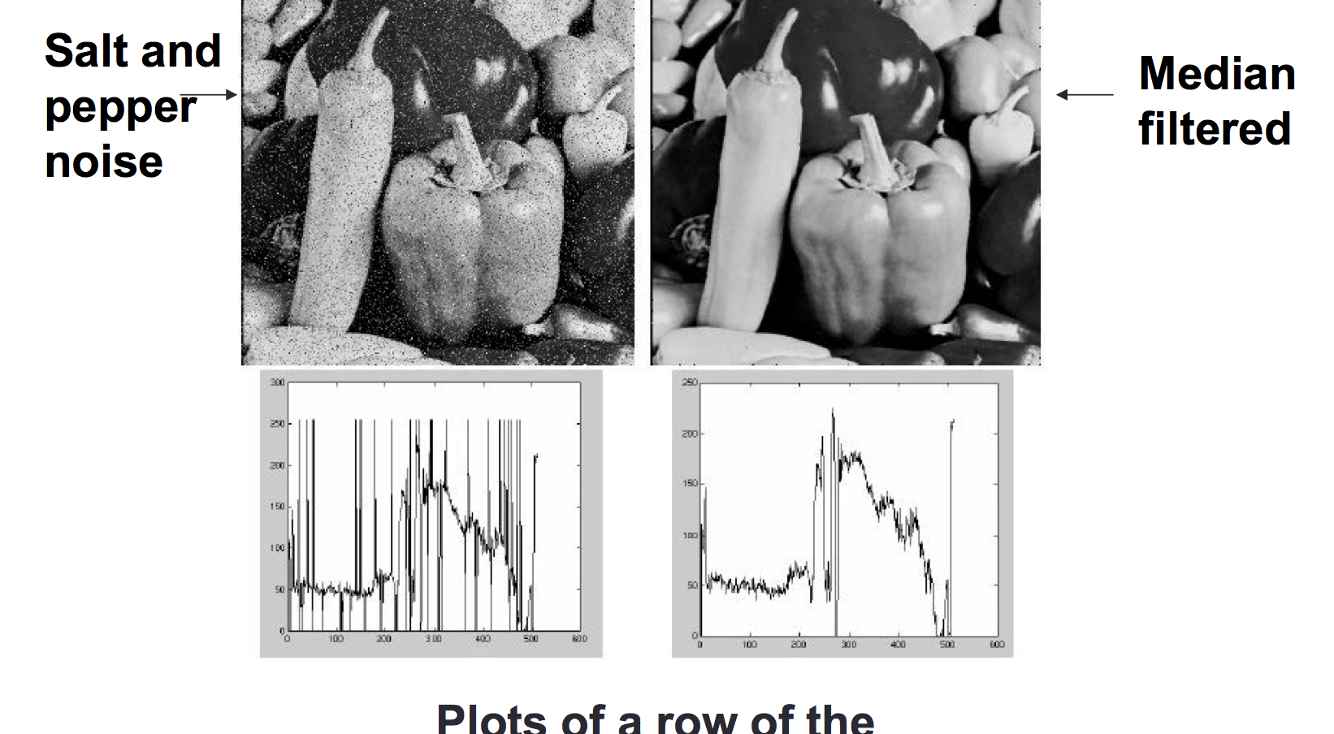
Median Filter
Plot of a row of the image

Slide 28
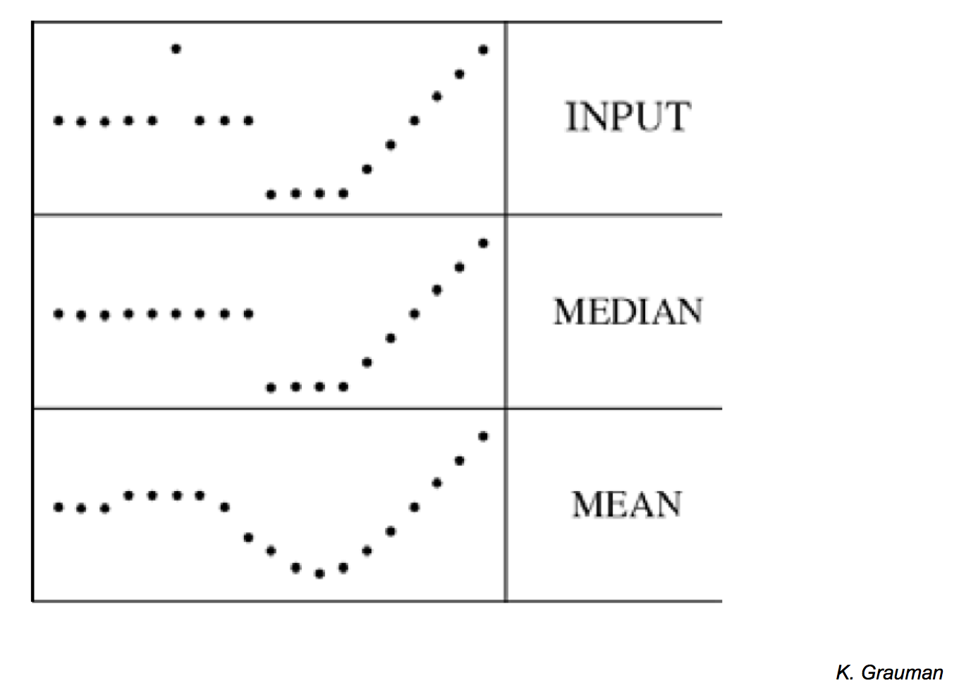
Median Filter
Median filter is edge preserving

Slide 29
Pros and Cons of median filter
Pros:
  The median is a more robust average than the mean and a single very unrepresentative pixel in a neighborhood will not affect the median value significantly.
  The median value must actually be from the image pixels, so the median filter does not create new unrealistic pixel values when the filter straddles an edge.
Cons:
  selecting one pixel one time, not as efficient as Gaussian

Slide 30
Median Filter in Pyton
med_denoised = ndimage.median_filter(noisy, windowsize)
Notes:
http://docs.scipy.org/doc/scipy-0.14.0/reference/generated/scipy.ndimage.filters.median_filter.html

Slide 31
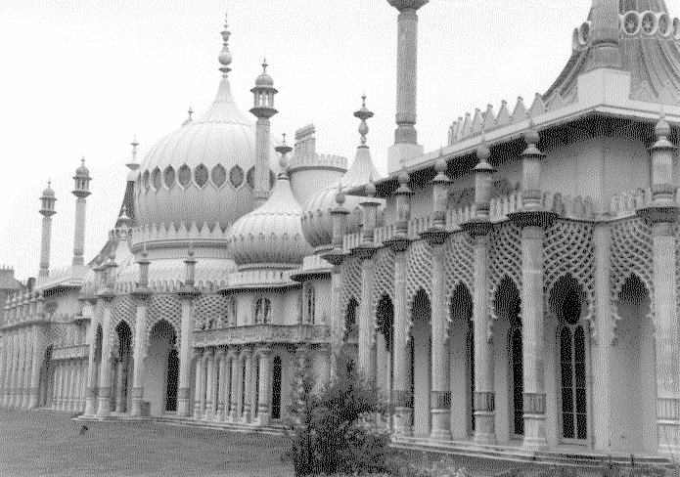
Exercise
Use the following image (uploaded in blackboard) and explore the effect of median filtering with different neighborhood size

Slide 32
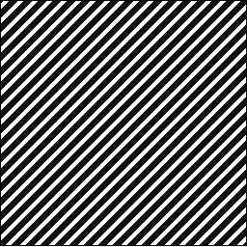
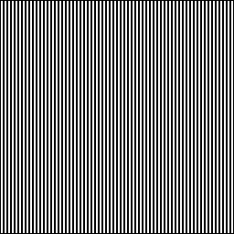
Exercise
Unlike Gaussian filter, median filter is nonlinear.
Median [A(x) + B(x)] = median[A(x)] + median[B(x)]
Illustrate this to yourself by performing smoothing and pixel addition (in the order above) to a set of test images

Slide 33
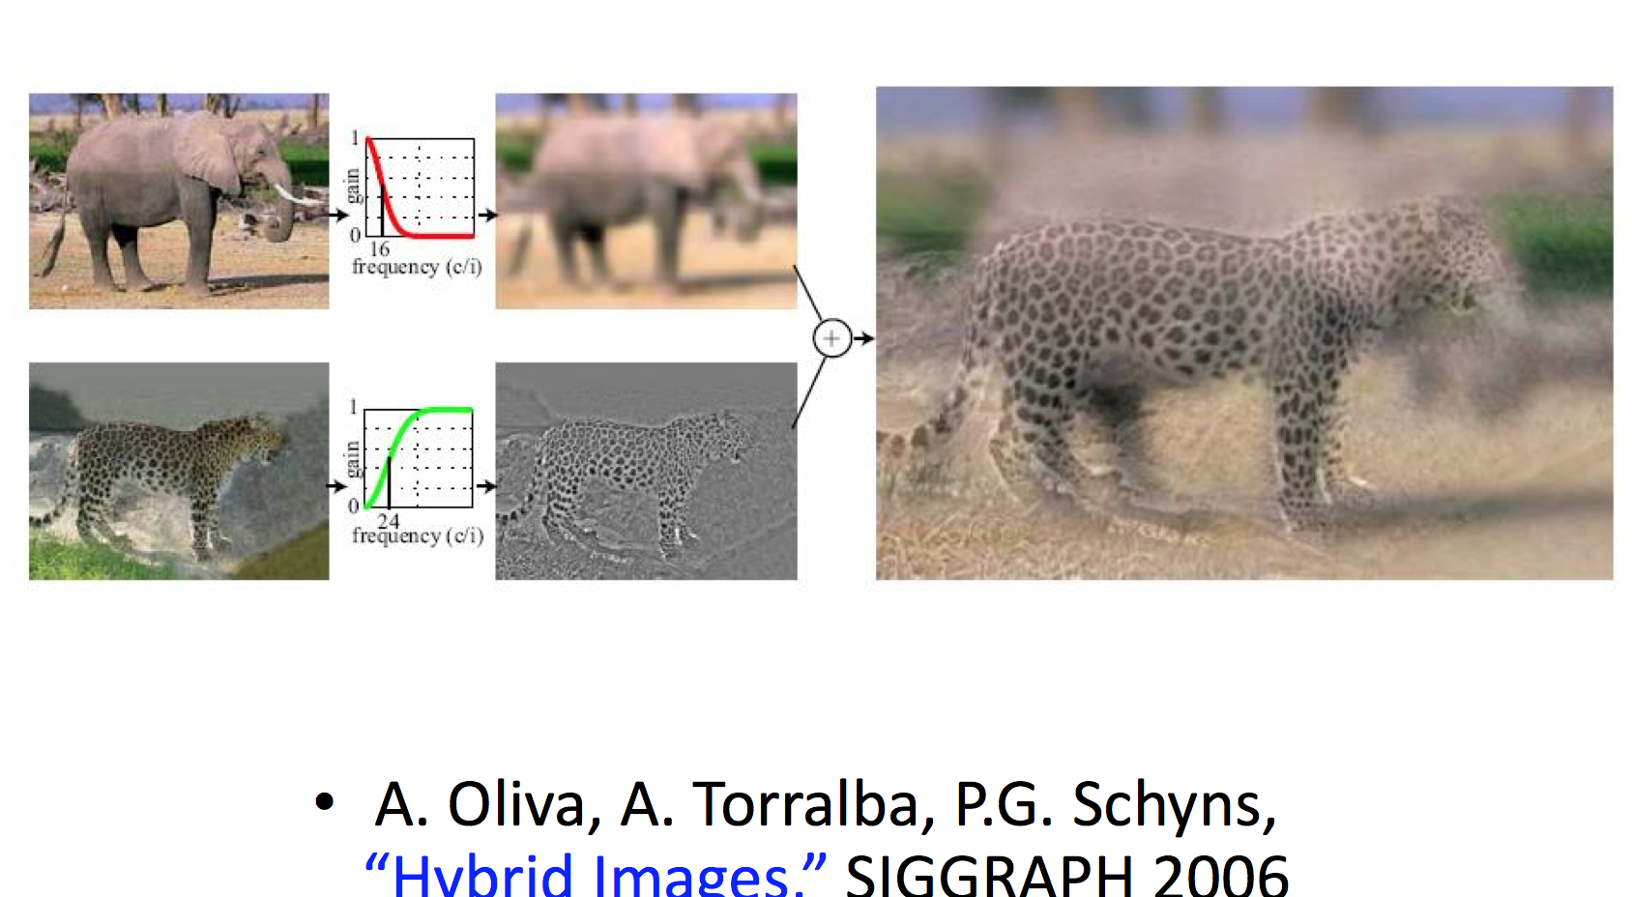
Hybrid Image

Slide 34
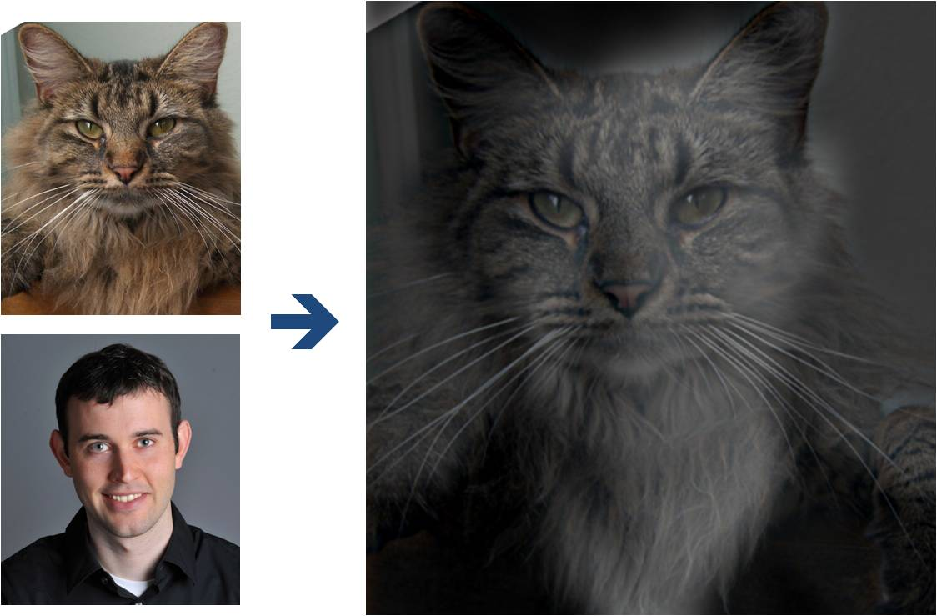
Why do we get different, distance-dependent interpretations of hybrid images?
?

Slide 35
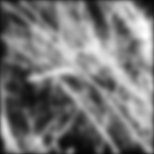

Why does the Gaussian give a nice smooth image, but the square filter give edgy artifacts?
Gaussian
Box filter
Notes:
Things we can’t understand without thinking in frequency

