Slide 1
For veterans with PTSD
Lauren Panzarino, Jared Mandel, Lauren Guglielmelli, Isaac Adlowitz

Slide 2
20%
560,000
Soldiers from Iraq & Afghanistan are diagnosed with PTSD
Soldiers with PTSD
22
Veterans commit suicide a day
86%
21%
Know someone killed/seriously injured
Domestic violence nationwide is caused by combat veterans with PTSD
Notes:
Lauren P

Slide 3
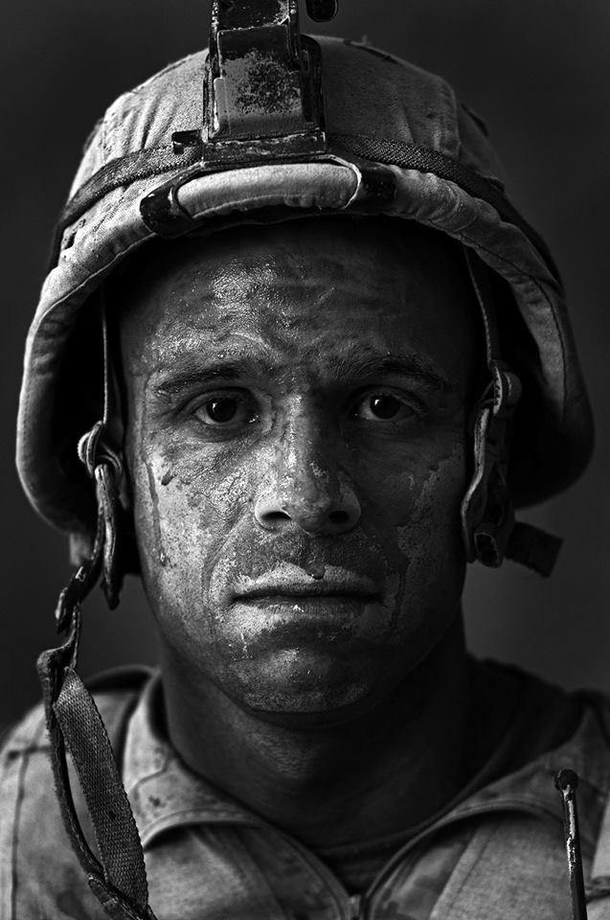
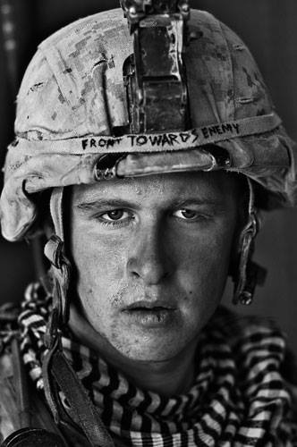
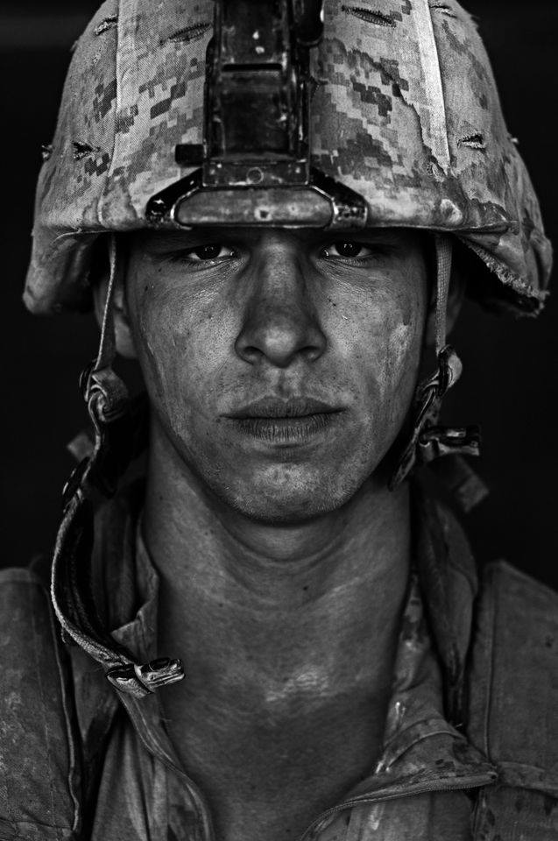
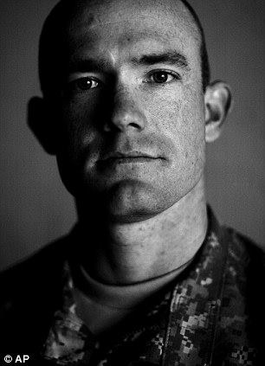
Notes:
Vivid night terrors
Traumatic flashbacks
High blood pressure
Depression
Anxiety
Strained relationships
Alcohol & Drug abuse
Brief overview
PTSd is characterized by these symptoms …. Also soldiers develop these when they come back.
In 12 years, 6,661 deaths during afganistan & iraq wars
In 1 year, 8,395 PTSD related suicides
PTSD related suicides claimed 1,734 more military personal in 1 year than the afghanistan and iraq wars have in 12 years
It's the "fight or flight" response, which is how the body responds to danger and threats. The heart beats faster, arteries constrict, blood pressure increases. The platelets in the blood become stickier, in preparation for clotting a potential wound. More glucose is pumped into the bloodstream, for quick energy. This can all save your life if you're being chased by a tiger. But when the process happens repeatedly over time, in response to chronic emotional stress, the lining of the arteries gets damaged. The heart muscle weakens. The effect is destructive, not protective.

Slide 4
Veteran TWINS’ STUDY
Incidence of Heart Disease based on PTSD status
Problem
Solution
Current Program
Costs
Timeline
Success
Benefits
Target
Notes:
This is from your own study. The study looked at 562 Veterans—281 twin pairs—who had been followed an average of 13 years. It found that heart disease was more than twice as common among those with PTSD
Perfectly illustrates
Causes early death from heart disease

Slide 5
Veterans Affairs PTSD Program
Step 1: Contact us
Step 2: Discuss your questions
Step 3: Review recommendations
Problem
Solution
Current Program
Costs
Timeline
Success
Benefits
Target
Notes:
The VA has a reputation for burecratic inefficiencies

Slide 6
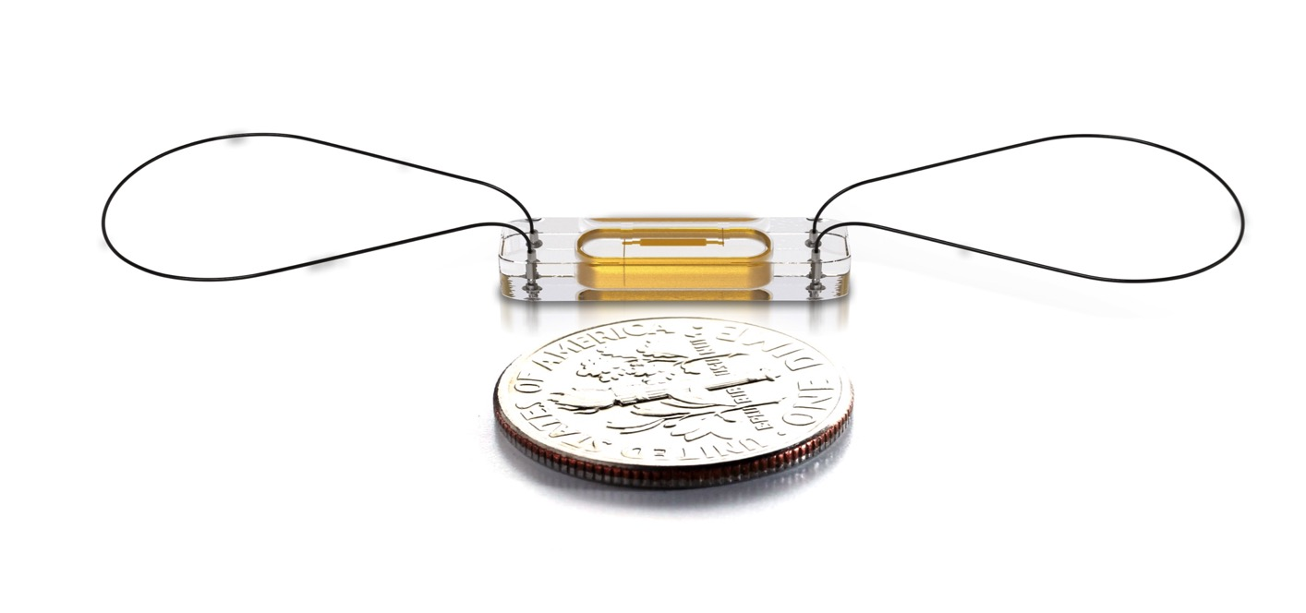
CardioMEMS
Problem
Solution
Current Program
Costs
Timeline
Success
Benefits
Target
Notes:
Cardio Microelectromechanical Systems
Describe the product & how it works
Statistics on reliability of cardioMEMS
Guaranteed lifetime - Permanent solution
Connection between
Minimally invasive surgery
15 minute surgery
Convenience
Security
Reliability

Slide 7
37%
REDUCTION IN HF HOSPITALIZATIONS
58%
REDUCTION IN HF REHOSPITALIZATION
Problem
Solution
Current Program
Costs
Timeline
Success
Benefits
Target
Notes:
Champion clinical trial
Tested 550 randomized patients who were hospitalized for heart failure within the past 12 months
#5 most innovative Health Care Company in world
St.Jude Medical Center has been working on ongoing studies.
How successful this has been in this context. Addressing these heart failure hospitalization.
As you can see these statistics from St. Jude’s prove its success.
2015
Above google
98.6% Free from complications

Slide 8
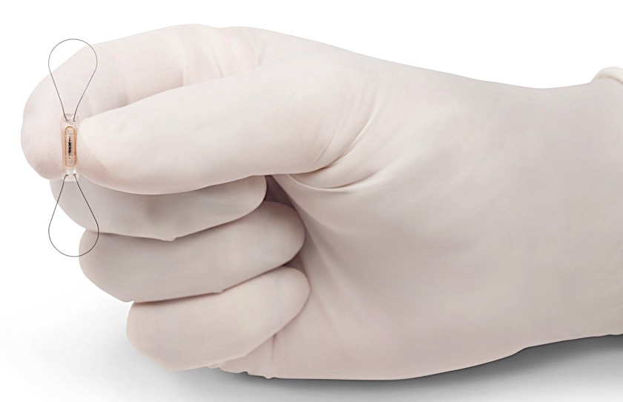
Costs
Fully loaded cost:
Max $20,000
Problem
Solution
Current Program
Costs
Timeline
Success
Benefits
Target
Notes:
Out of Pocket: $20,000
Surgery/Hospital Visits: $60,000-$80,000
$17,000 reimbursement

Slide 9
Target Market
560,000
Soldiers with PTSD
118,000
Soldiers with PTSD and Heart Failure
Problem
Solution
Current Program
Costs
Timeline
Success
Benefits
Target
Notes:
Quality of Life Research in December 2013.
Study of 5,574 Veterans
Vietnam Era Twin Registry
mail surveys and telephone interviews

Slide 10
Target Market
Rehospitalization
Problem
Solution
Current Program
Costs
Timeline
Success
Benefits
Target
3rd Hospitalization

Slide 11
COST PER VETERAN Without CardioMEMS
HF Hospitalizations
+
HF Rehospitalization +
PTSD Treatment
Total: $67,000

Slide 12
COST PER VETERAN With CardioMEMS
Cost of Device
+
⬇37% of HF Hospitalizations
+
⬇58% of HF Rehospitalization +
⬇10% of PTSD Treatment
Total: $50,000

Slide 13
Return on Investment
$17,000 savings per Veteran in 7 yrs
$1.5 billion total savings in 7 yrs
ROI =13%
Problem
Solution
Current Program
Costs
Timeline
Success
Benefits
Target
Notes:
$17,000 savings per Veteran in just 7 years

Slide 14
Benefits
Reduce costs of heart failure hospitalizations
Reduce number of suicides
Reduce incidents of harm to other people
Problem
Solution
Current Program
Costs
Timeline
Success
Benefits
Target

Slide 15
Risks
Chance of Complications ➔1.4%
Possibility of lower success rates
Notes:
Sample size/population could equate to

Slide 16
Implementation Timeline
Invest in CardioMEMS
Develop new PTSD Program
Pilot Program
6 Months
6 Months
Problem
Solution
Current Program
Costs
Timeline
Success
Benefits
Target
18 Months
Notes:
Washington D.C. VA Medical Center

Slide 17
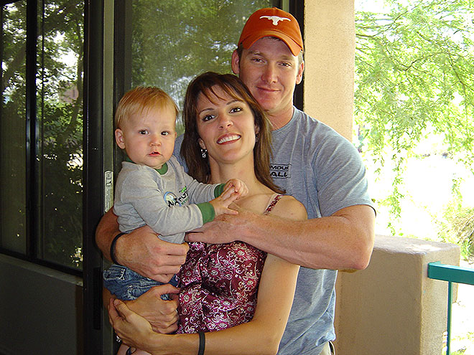
Notes:
The VA claims to be committed to ensuring the wellbeing of soldiers, and their wives and children, but fails to provided the necessary precautionary measures to anticipate PTSD outbursts. The sad truth is that there have been numerous cases of soldiers who suffer from extreme cases of PTSD that have committed suicide and murdered their wives and children on account of their mental instability due to the disorder.
He was able to overcome it
Bonding with a shooting range, and the guy shot him due to his PTSD
This is a tregya nd this is what we are trying to prevent
This could have been caught and prevented if he cardimemes

Slide 18
Lauren Panzarino, Jared Mandel, Lauren Guglielmelli, Isaac Adlowitz

Slide 19
Appendix
Breakdown of Costs
Comparable heart rate monitor devices
Science behind the technology
Heart Rate Variability: PTSD vs. no PTSD
Heart Rate solider with PTSD vs. Solider without PTSD

Slide 20
COST Breakdown
23,000 * 100% = 23,000
23,000 * 25% = 6,000
23,000 *12.5% = 3,000
35,000 * 100% = 35,000
Total Costs=67,000

Slide 21
91,000
Hospitalizations
Rehospitalization
-37%
-58%
-58%
3rd hospitalization

Slide 22
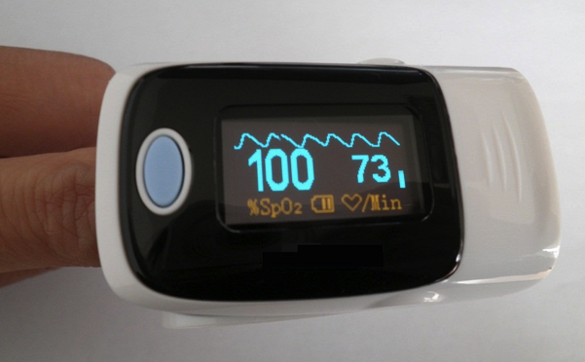
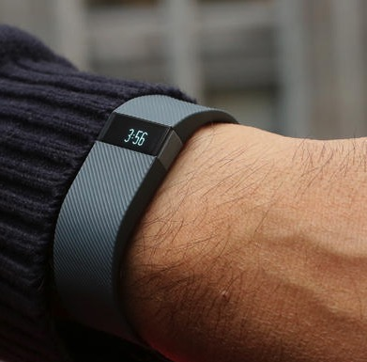
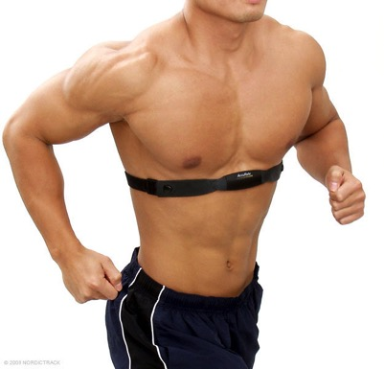
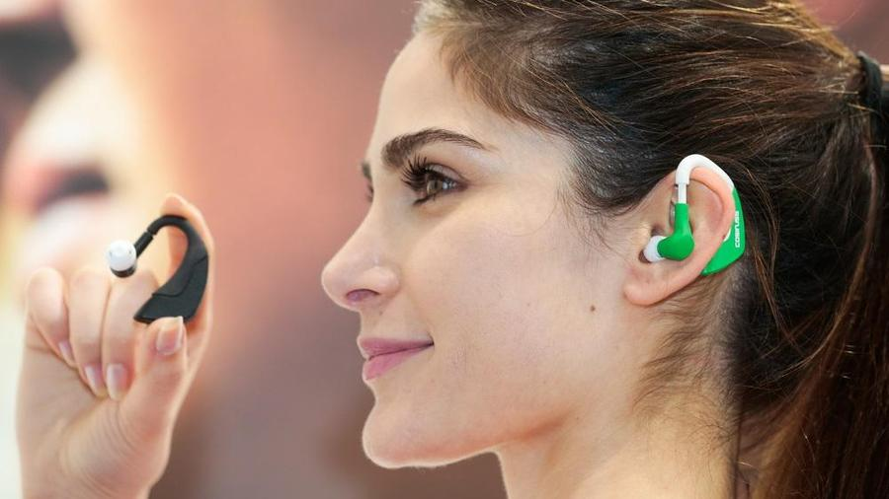
Other heart rate monitoring devices

Slide 23
CardioMems in pulminary artery

Slide 24
Biological Psychiatry Study
Published Dec. 1, 2013
663 Veterans at two VA sites in California
Patients walked on a treadmill while hooked up to an EKG
Those with PTSD had EKGs showing reduced blood flow to the heart
Notes:
, which traces the heart's electrical activity as it pumps blood.

Slide 25
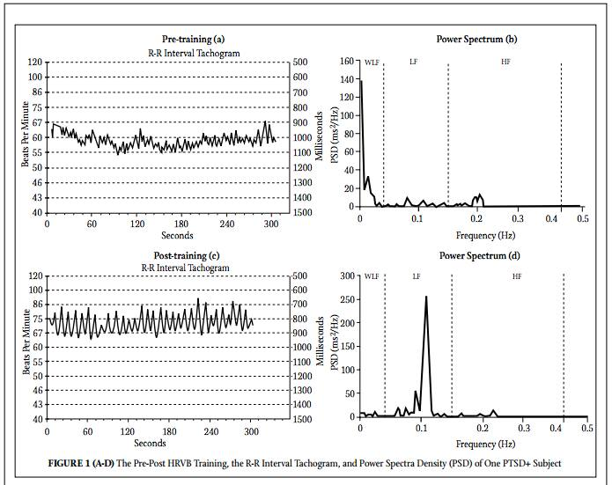

Slide 26
Works Cited
"1 in 8 Returning Soldiers Suffers from PTSD." Msnbc.com. NBC News, 30 June 2004. Web. 18 Feb. 2015. <http://www.nbcnews.com/id/5334479/ns/health-mental_health/t/returning-soldiers-suffers-ptsd/#.VTbYFRPF9RA>.
"CardioMEMS HF System." St. Jude Medical. St. Jude Medical, Inc., n.d. Web. <http://www.sjm.com/cardiomems>
Koprowski, Gene J. "Hospitals Trial Wireless Heart Monitor Technology." Fox News. FOX News Network, 31 Oct. 2014. Web. 18 Feb. 2015. <http://www.foxnews.com/tech/2014/10/31/hospitals-trial-wireless-heart-monitor-tec>.
"You've Served Your Nation with Honor. Now, Let VA Serve You." U.S. Department of Veterans Affairs. U.S. Department of Veterans Affairs, 5 Mar. 2015. Web. 06 Apr. 2015. < http://www.va.gov/opa/>.
Carney, Jordian. "Why Are So Many Older Veterans Committing Suicide?" National Journal Group Inc. National Journal Group Inc., 14 Apr. 2014. Web. 06 Apr. 2015. <http://www.nationaljournal.com/defense/why-are-so-many-older-veterans-committing-suicide-20140413>.
Fantz, Ashley. "The Uncounted." CNN. Cable News Network, n.d. Web. 06 Apr. 2015.
<http://www.cnn.com/interactive/2014/03/us/uncounted-suicides>.
"Coming Home From Deployment: The New “Normal”." Coming Home From Deployment: The New “Normal” (n.d.): n. pag. American Red Cross. The American National Red Cross, Jan. 2011. Web. 6 Apr. 2015. <http://www.redcross.org/images/MEDIA_CustomProductCatalog/m4240149_SAFComingHomeBrochure.pdf>.

Slide 27
Works Cited
EDITORS. "CardioMEMS HF System for Pulmonary Pressure Monitoring in Heart Failure Patients Approved by FDA (VIDEO)." CardioMEMS HF System for Pulmonary Pressure Monitoring in Heart Failure Patients Approved by FDA (VIDEO). Medgadget LLC., 24 May 2014. Web. 06 Apr. 2015. http://www.medgadget.com/2014/05/cardiomems-hf-system-for-pulmonary-pressure-monitoring-in-heart-failure-patients-approved-by-fda-video.html.
Gloverner, Lacie. NerdWallet. NerdWallet, Inc., 19 May 2014. Web. 06 Apr. 2015. <http://www.nerdwallet.com/blog/health/2014/05/19/ptsd-post-traumatic-stress-disorder-statistics-veterans>.
Jones, Ann. "How America's Wars Came Home With the Troops." The Nation. The Nation, 17 Apr. 2014. Web. 06 Apr. 2015. <http://www.tomdispatch.com/post/175832/tomgram%3A_ann_jones,_star-spangled_baggage>.
"St. Jude Medical and CardioMEMS Announce FDA Approval of the CardioMEMS Heart Failure Management System." St Jude Medical -. St. Jude Medical, Inc., 28 May 2014. Web. 06 Apr. 2015. <http://media.sjm.com/newsroom/news-releases/news-releases-details/2014/St-Jude-Medical-and-CardioMEMS-Announce-FDA-Approval-of-the-CardioMEMS-Heart-Failure-Management-System/default.aspx>.
CardioMEMS Device Reduces Heart Failure Hospitalizations. Perf. Ronald Freudenberger. YouTube. YouTube, 31 Aug. 2014. Web. 06 Apr. 2015. <https://www.youtube.com/watch?v=DREYQ6a9BIQ>.
"CardioMEMS HF System." Interview by Jay S. Yadav. YouTube. YouTube, 28 May 2014. Web. 06 Apr. 2015. <https://www.youtube.com/watch?v=OVwEpL6cT-A>.
"U.S. Food and Drug Administration." CardioMEMS HF System. U.S. Food and Drug Administration, 18 June 2014. Web. 06 Apr. 2015. <http://www.accessdata.fda.gov/scripts/cdrh/cfdocs/cfTopic/pma/pma.cfm?num=p100045>.

