Slide 1
Immersive Music: the future of the record industry
Presented to Columbia Records
Sam Krause, Taylor Heywood, Greg Snyder, Talal Barazi

Slide 2
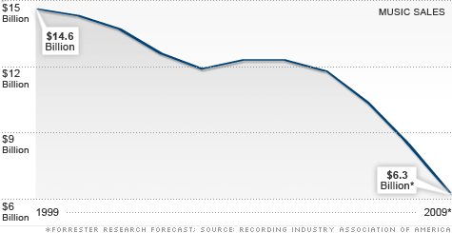
Music Industry Revenue

Slide 3
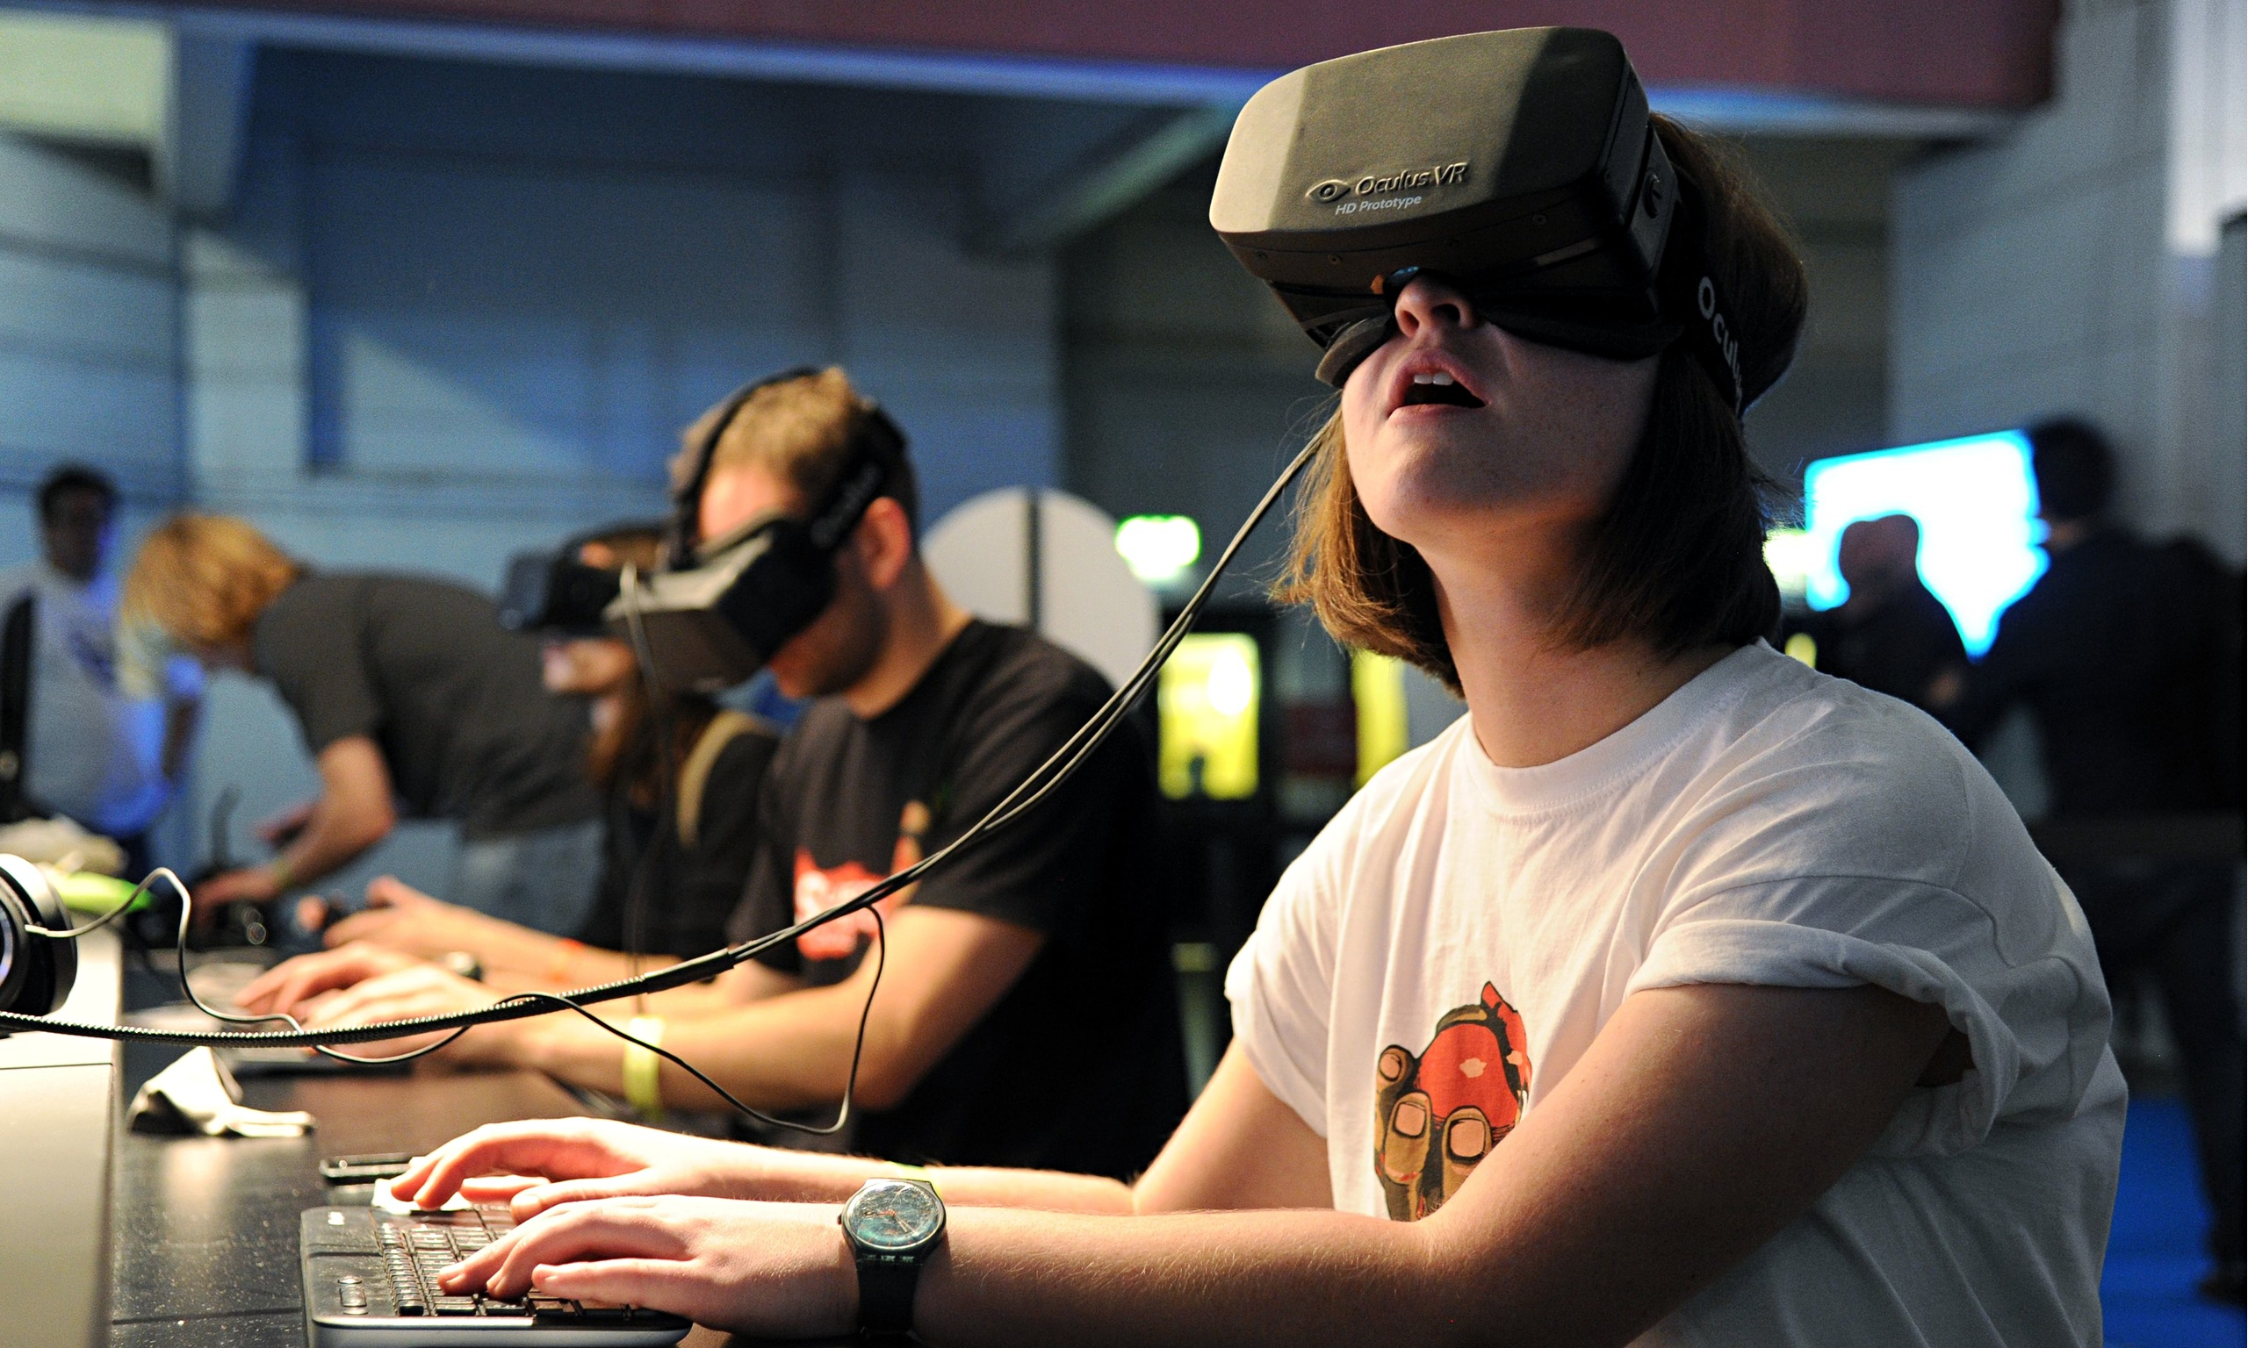

Slide 4
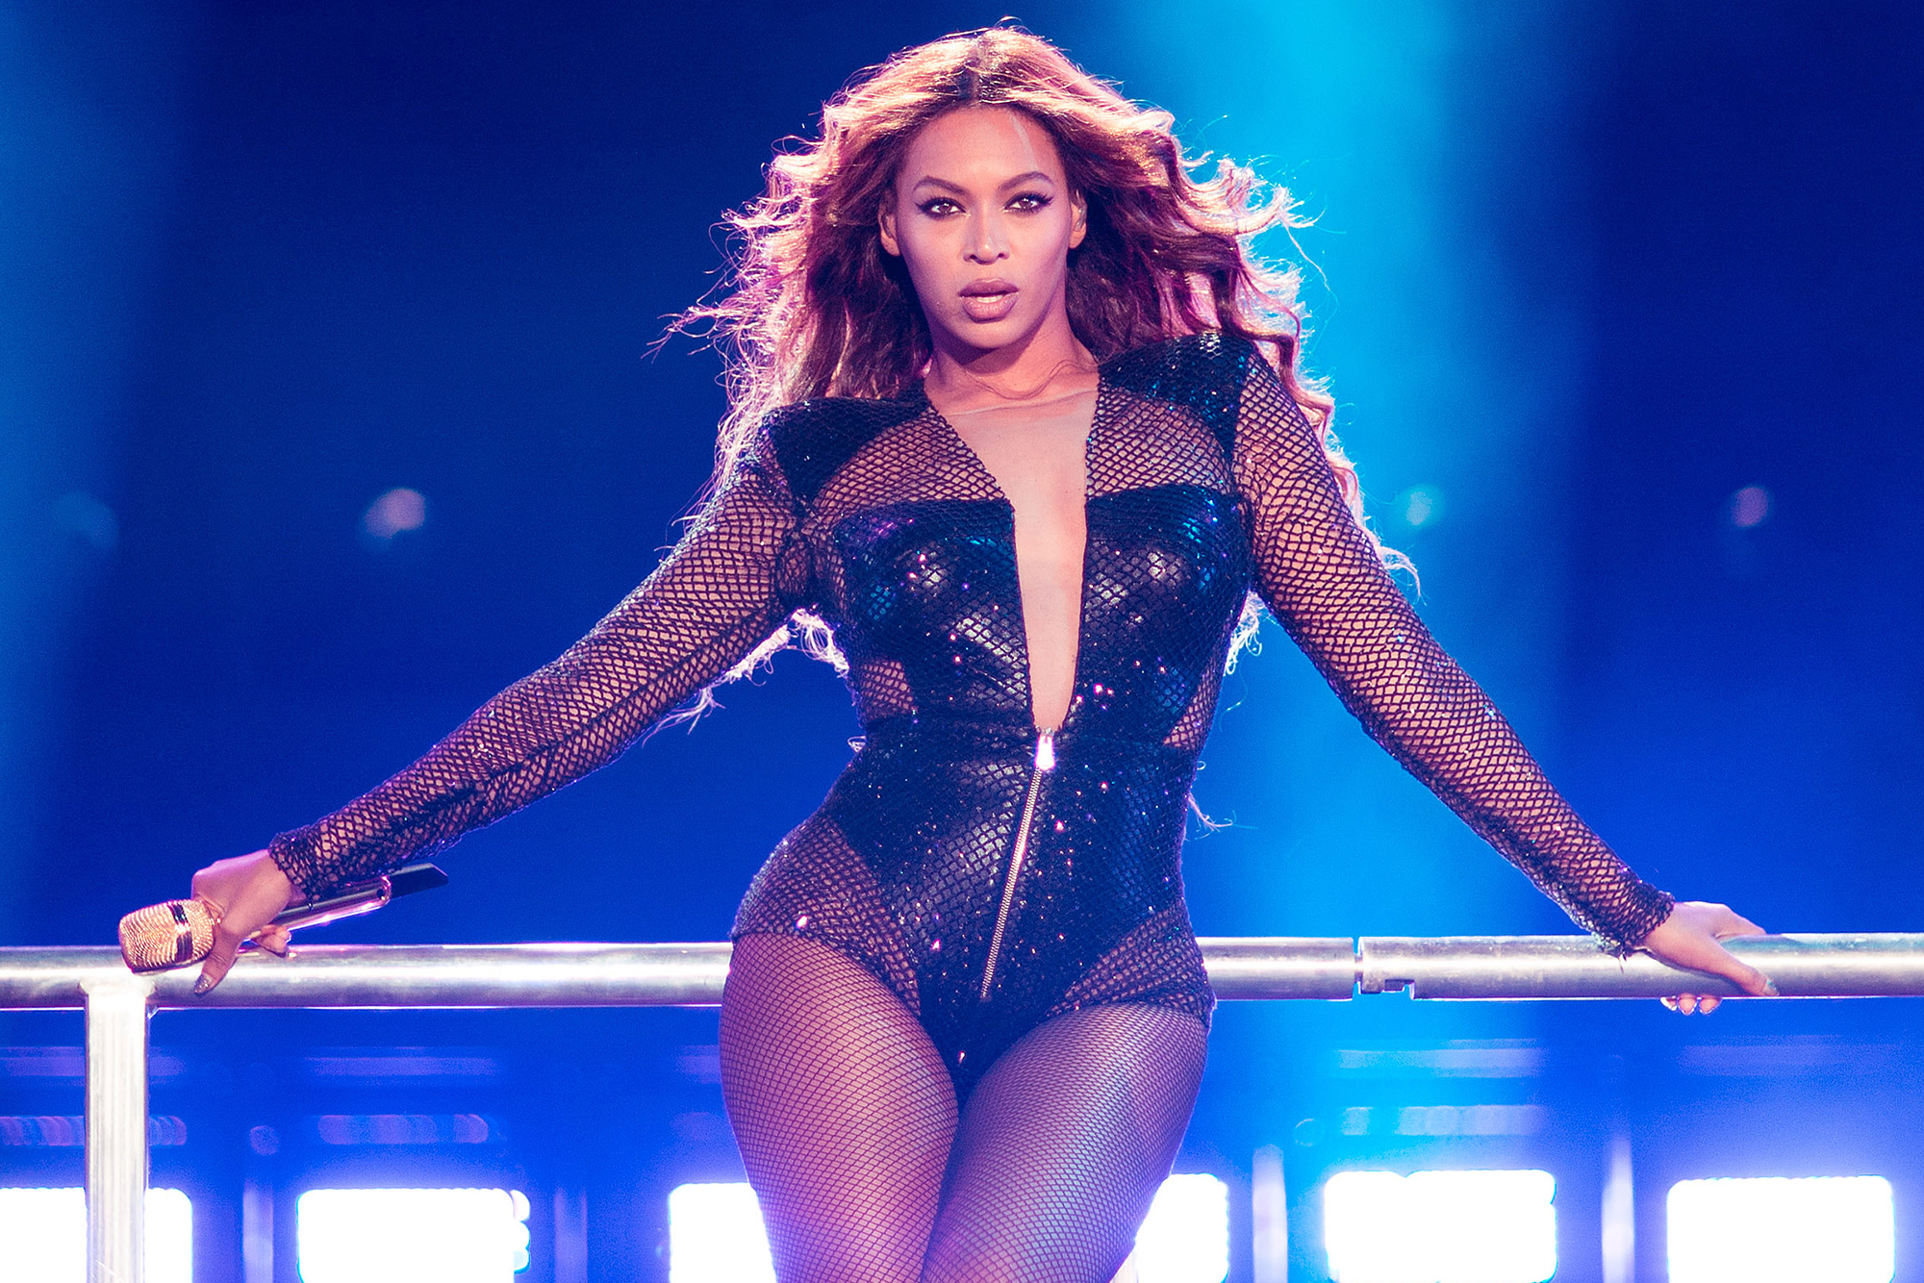

Slide 5
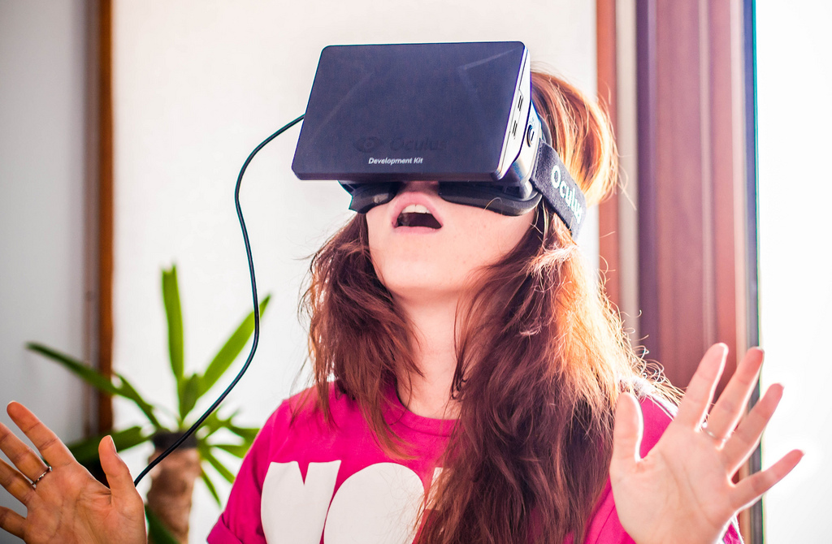

Slide 6
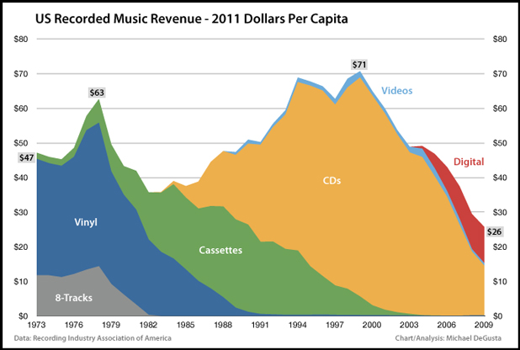
[some pictures of the brands and maybe do it in smart art, whatever works – put however many slides here that you need to make it work] – also pull that graph out of the google doc and model your explanation of the problem around that perhaps

Slide 7
$71
$63

Slide 8
$26

Slide 9
The Content
Live Concerts
Immersive Albums

Slide 10
Advances In VR
Latency
Field of View
Affordability

Slide 11
Compatible Headsets

Slide 12
How It Works
Film
Format
Load
Watch

Slide 13
Possible Formats

Slide 14
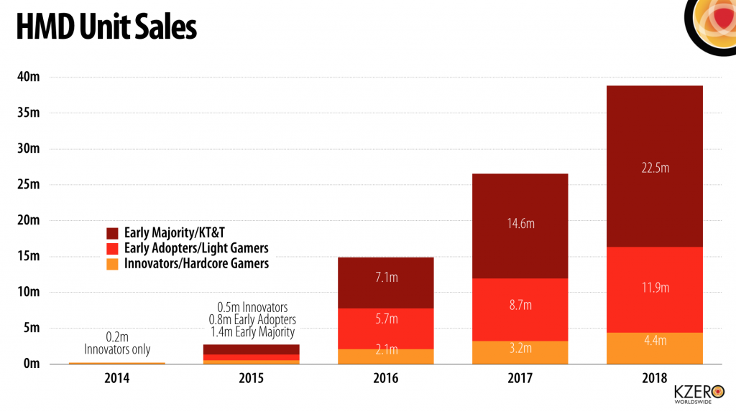
Graph of HMD unit sales

Slide 15
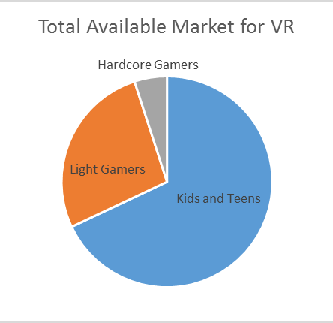
Total Market for VR Headsets
300.2MM

Slide 16
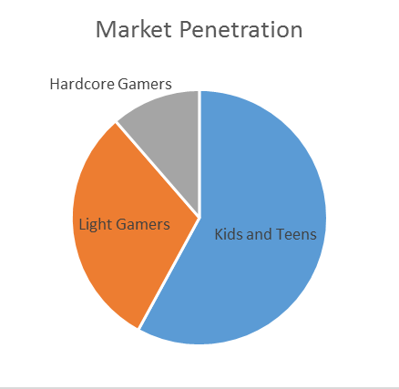
Market Penetration in 2018
300.2MM
22.5MM

Slide 17
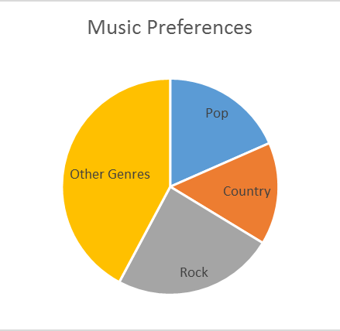
The Market for Immersive Music
300.2MM
22.5MM
4.1MM

Slide 18
Extended Financials
Unit Price: $40
Contribution Margin: $24
Breakeven Units: 204,167
Profit Potential: $31,830,000

Slide 19
Fixed Costs
Investment per album cycle (in USD)
Advance | 50,000 – 350,000
Recording | 150,000 – 500,000
Video Production | 300,000 – 2,500,000
Tour Support | 50,000 – 150,000
Marketing and Promotion | 400,000 – 1,400,000
Total | 950,000 – 4,900,000

Slide 20
Fixed Costs
Investment per album cycle (in USD)
Advance | 50,000 – 350,000
Recording | 150,000 – 500,000
Video Production | 300,000 – 2,500,000
Tour Support | 50,000 – 150,000
Marketing and Promotion | 400,000 – 1,400,000
Total | 950,000 – 4,900,000

Slide 21
ROI in the Music Industry
1 - 3 - 6

Slide 22
Return on Investment
Flop
Between -61% and -65%
Success
Between 650% and 886%
Weighted Average ROI: 28% to 51%

Slide 23


Risk Mitigation – Piracy and Streaming

Slide 24
Piracy Prevention
Serial Copy Management System
Reduced Piracy
Window of Opportunity
Additional upload prevention

Slide 25
Summary – The Bottom Line
New Market
High Margin Product
ROI between 28% and 51%

Slide 26
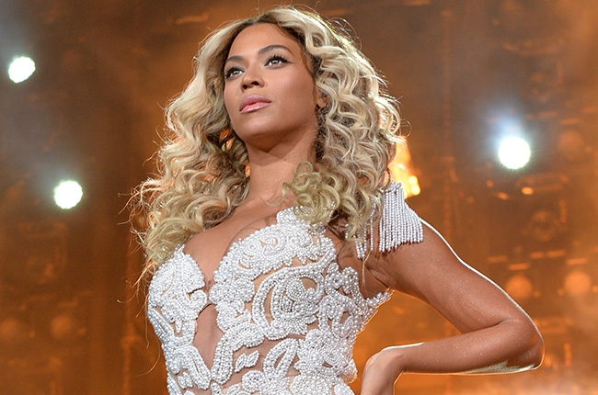

Slide 27
Immersive Music: the future of the record industry
Presented to Columbia Records
Sam Krause, Taylor Heywood, Greg Snyder, Talal Barazi

Slide 28
Table of Contents – Appendices
1: Financials
2: Assumptions
3: ROI Calculations
4: Breakeven Calculations
5: Spotify Growth and Income
6: Pandora Growth and Income
7: The History of Virtual Reality
8: 360 Degree Filming
9: Photo Sources

Slide 29
Appendix One: Financials

Slide 30
Appendix Two: Assumptions

Slide 31
Appendix Three: ROI Calculations

Slide 32
Appendix Four: Breakeven Analysis
Typical CD
75,000 – 290,000
VR Album
39,000 – 204,000
COD ELITE
1,100,000

Slide 33
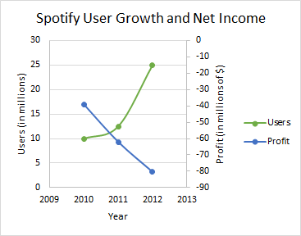
Appendix Five: Spotify Growth and Income

Slide 34
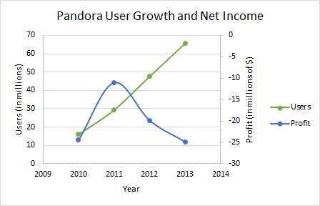
Appendix Six: Pandora Growth and Income

Slide 35
Appendix Seven: The History of Virtual Reality
The Idea
The Failures
The Modern Era

Slide 36
Appendix Eight: 360 Degree Filming

Slide 37
Appendix Nine: Photo Sources
www.oculus.com
spectrum.ieee.org
discovermagazine.com
nypost.com
www.wired.com
www.oculus.com
www.dnaindia.com
www.zmescience.com
http://www.businessinsider.com
theguardian.com
billboard.com
stormfestsa.co.za
solidsignal.com
www.windowsmania.com.br
wallpaperus.org
financesonline.com
oculusriftonline.com
www.extremetech.com
http://money.cnn.com/2/
www.provicom.tv
www.gizmag.com529 × 298
www.allkeyshop.com
www.amazon.de
www.playstation.com
www.veoh.com
www.nctechimaging.com
www.billboard.com

