Slide 1
The Discrepancy

Slide 2
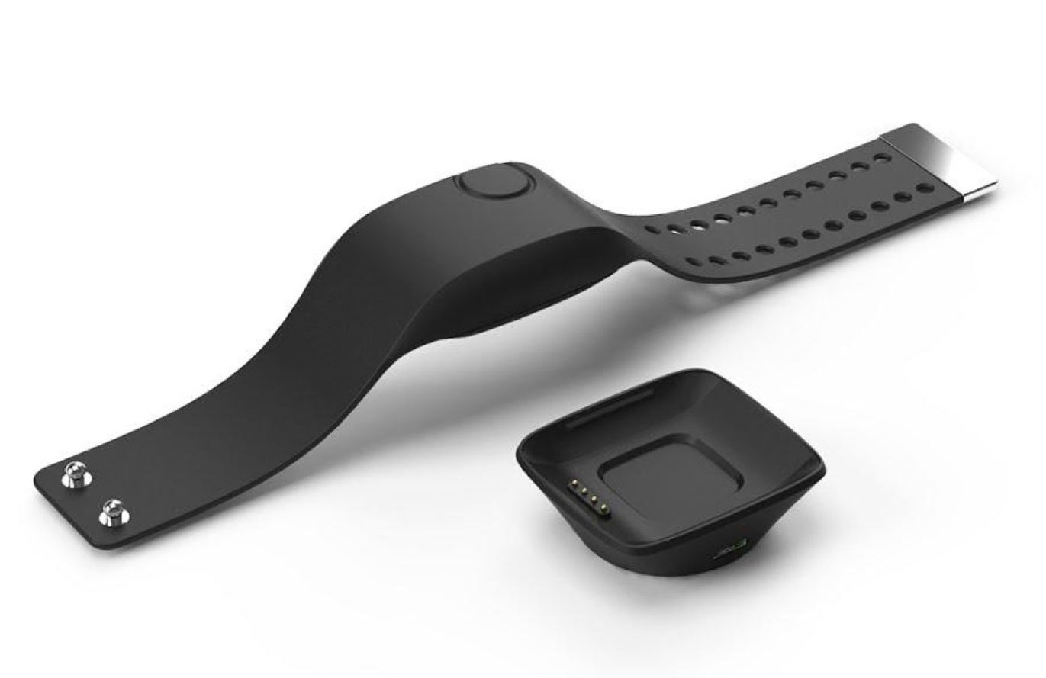
Empatica, Impact Your Life
Minh Nguyen, Leah Tholen, Joseph Santiago and Afryea Nophlin

Slide 3
Overview
E4 Description
Background
Technology Implementation
Challenges
Future Outlooks
Finance

Slide 4
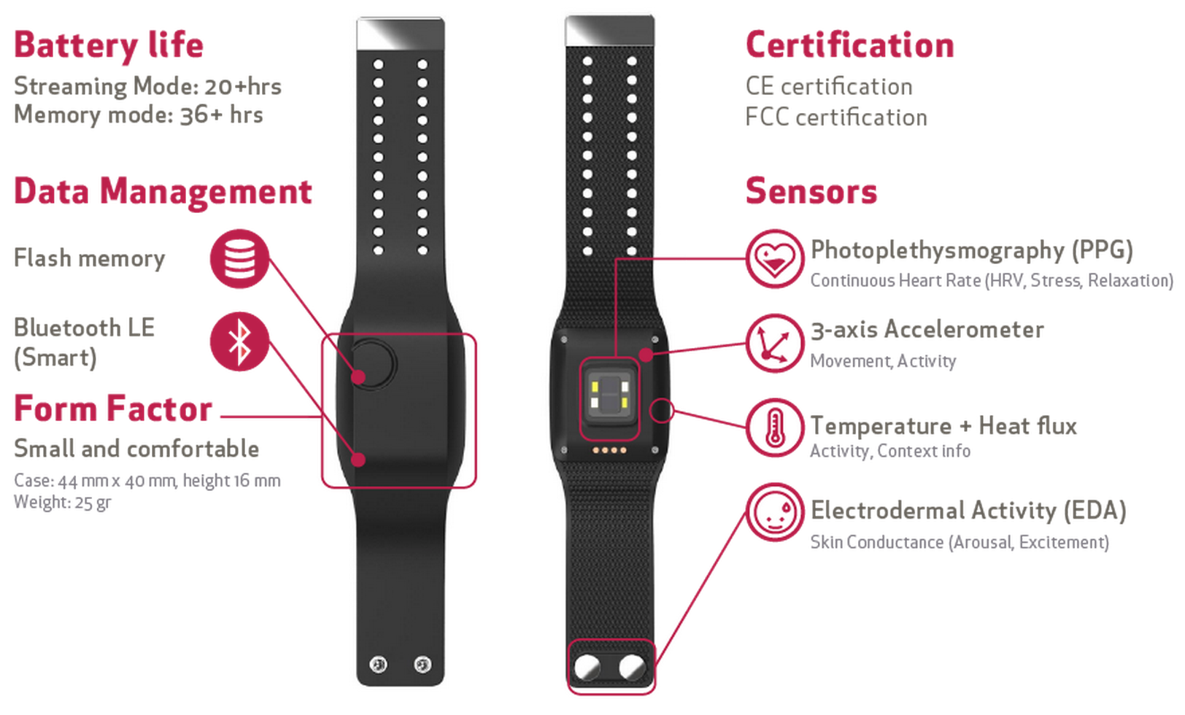
Empatica
E4
Background
Execution
Challenges
Future Outlooks
Finances

Slide 5
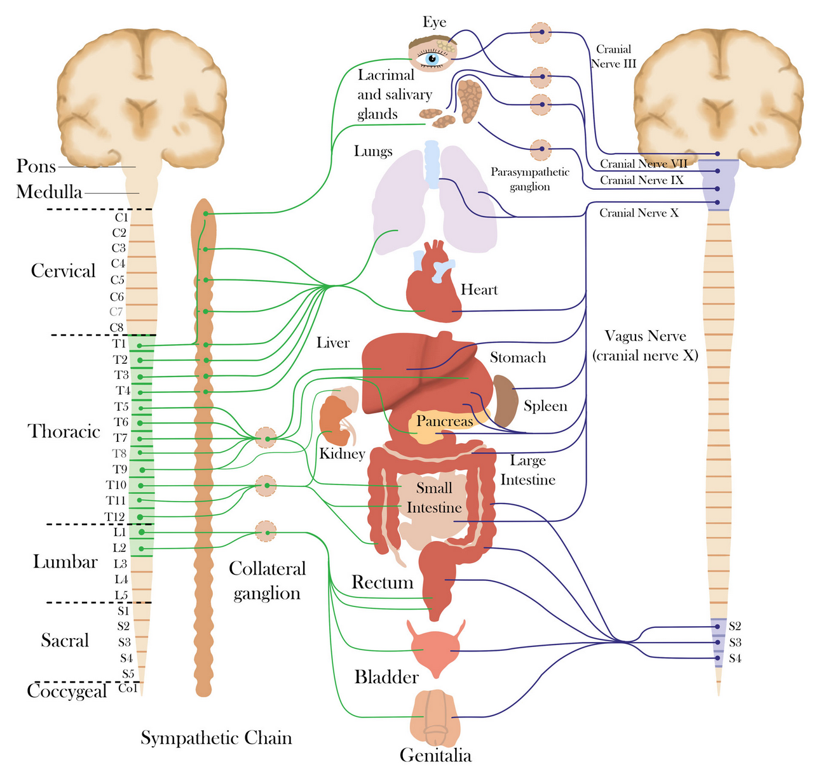
Empatica
E4
Background
Execution
Challenges
Future Outlooks
Finances
Track changes with the central nervous system
Monitors minor electrical changes

Slide 6
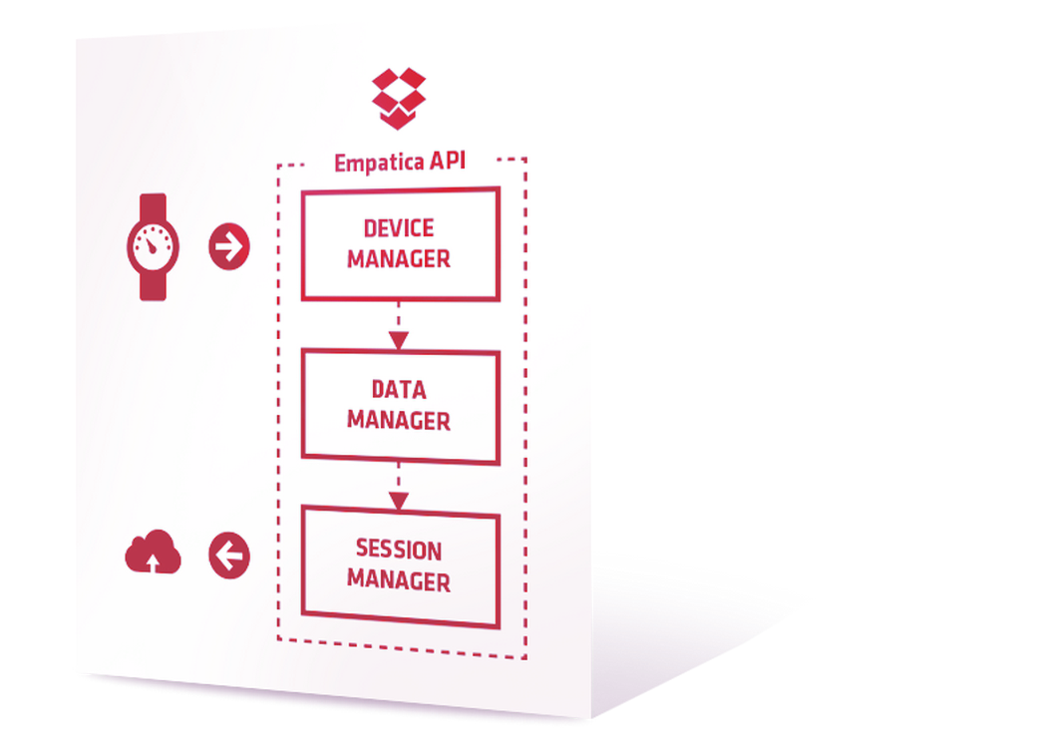
Background
E4
Background
Execution
Challenges
Future Outlooks
Finances
E4 Empatica
Designed to save lives
Medical field
Seizures
Epilepsy
Education
Improve comprehension
Academic integration

Slide 7
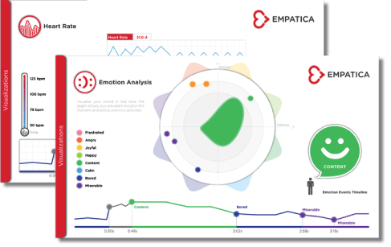
Empatica
E4
Background
Execution
Challenges
Future Outlooks
Finances
Wristband
Monitors human functions
Data conversion
Relay information
Through customized UI

Slide 8
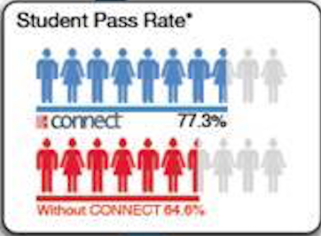
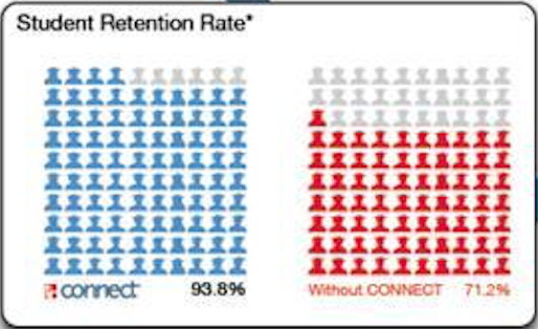
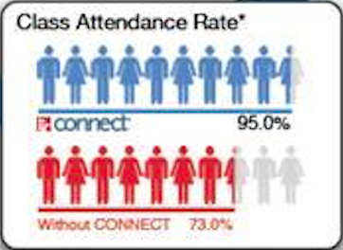
Why McGraw-Hill
E4
Background
Execution
Challenges
Future Outlooks
Finances

Slide 9
Competitive Advantage
E4
Background
Execution
Challenges
Future Outlooks
Finances
Original learning device
First-movers advantage
Advance education
Product lifecycle

Slide 10
Technology Implementation
E4
Background
Execution
Challenges
Future Outlooks
Finances
Calibration
Measure stress level
Differentiate personal vs. educational stress
Relay information
Instructor take action

Slide 11
Potential Challenges
E4
Background
Execution
Challenges
Future Outlooks
Finances
Information Security
Transparency
Parental consent
Data Accuracy
2 weeks calibration
Communication
Cost and Expansion
Payment plan
Creating value

Slide 12
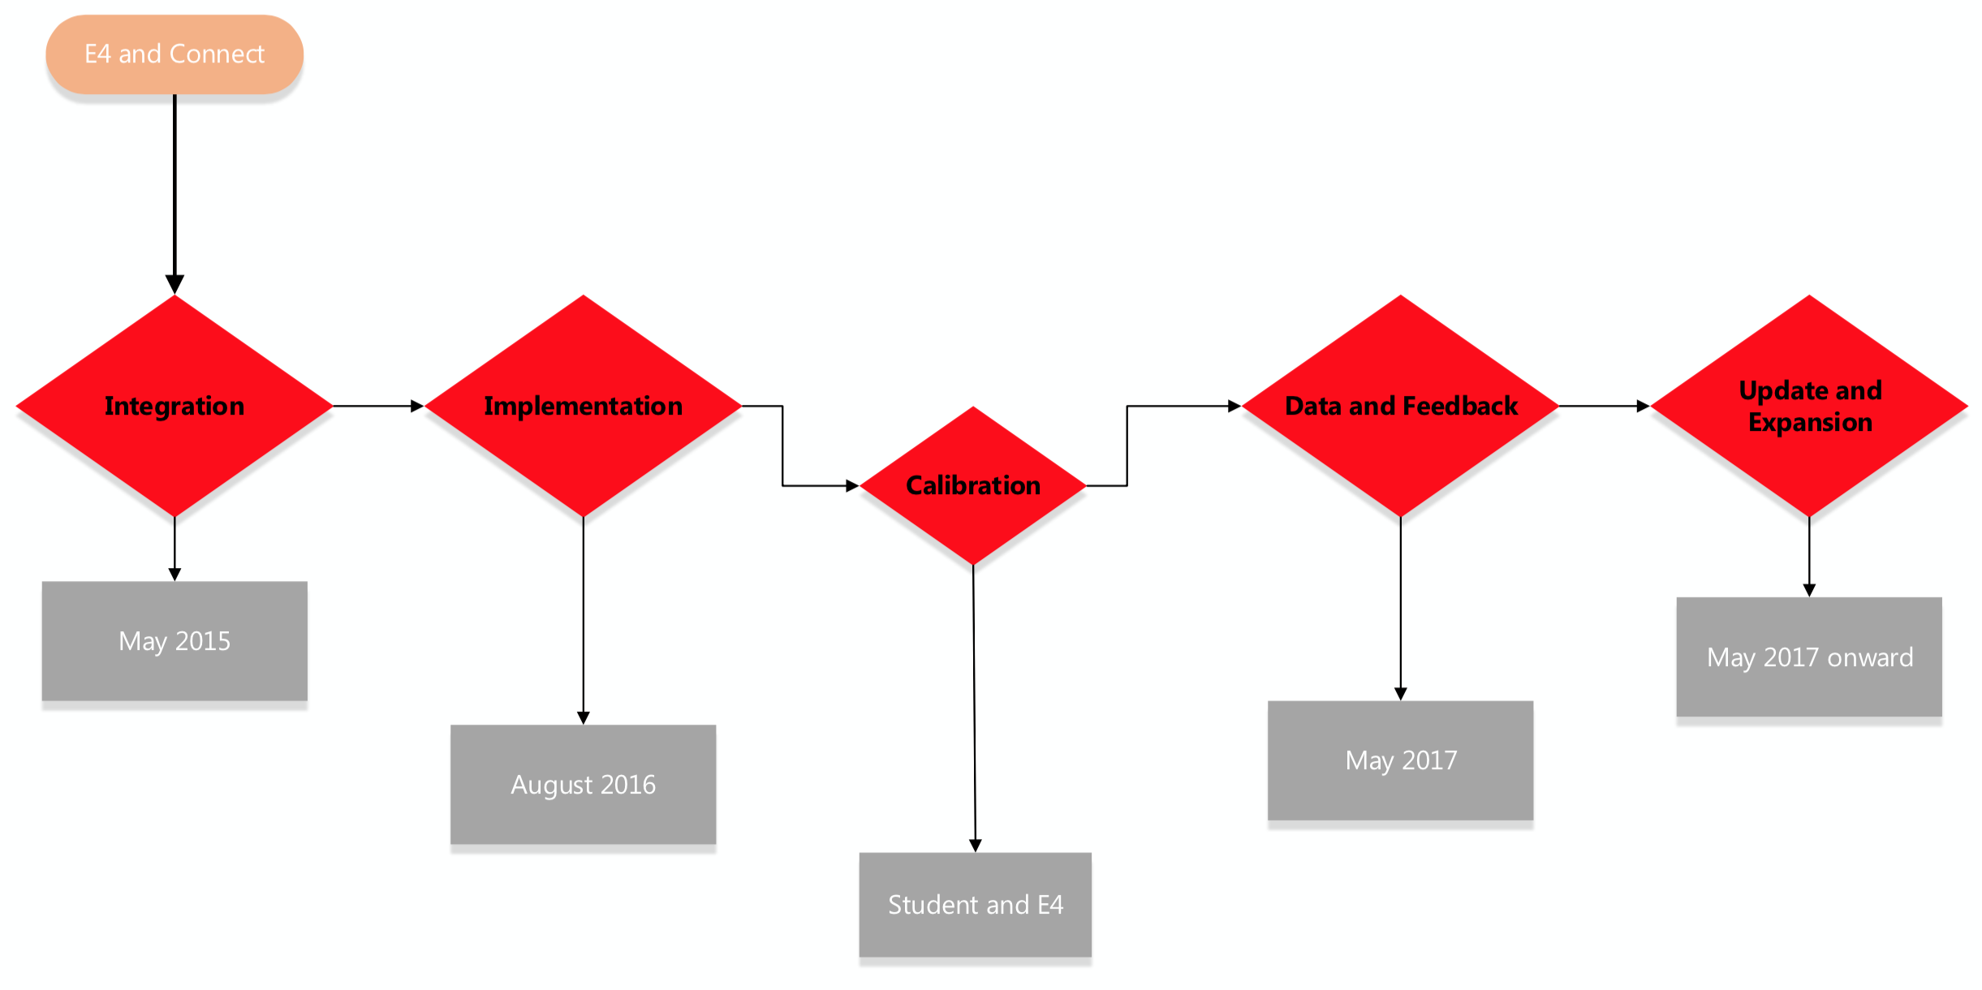
Future Outlooks
E4
Background
Execution
Challenges
Future Outlooks
Finances

Slide 13
Future Outlooks
E4
Background
Execution
Challenges
Future Outlooks
Finances
Integration May 2016
Integrate Empatica with Connect
Stress differentiation
Product calibration
Market product

Slide 14
Future Outlooks
E4
Background
Execution
Challenges
Future Outlooks
Finances
Implementation August 2016
Private schools and Montessori schools
Calibration
Match students with Empatica

Slide 15
Future Outlooks
E4
Background
Execution
Challenges
Future Outlooks
Finances
Data and Feedback May 2017
Data analysis
User feedback
Students
Teacher
Parents

Slide 16
Future Outlooks
E4
Background
Execution
Challenges
Future Outlooks
Finances
Update and Expansion May 2017 onward
Utilize feedback to upgrade firmware
Improve UI if needed
Expand to other schools

Slide 17
Finances
E4
Background
Execution
Challenges
Future Outlooks
Finances
Cost per unit | $275
Suggested Retail Price | $400
Population currently using Connect software | 34%
Projected Population (2015-2020) | 40% of all private school students between 3rd-8th grade
Projected Population (2020-2025) | 40% of all school students between 3rd-12th grade

Slide 18
Finances
*All numbers in the millions.

Slide 19
Summary
Independence of Connect
Diversify Customer Base
Customer base expands
Disconnects Connect Software from text-based products
Notes:
E4 will differentiate McGraw Hill Education from its competitors
E4 cannot be replicated easily due to sheer development cost
No other company in production of healthcare-grade biometric devices
Empatica will remain exclusive with McGraw Hill Education
Innovative
Sole developer
Diversify Customer Base
Customer base expands
Exclusive
Exclusive Partners

Slide 20
Summary
Competitive advantage
Key Differentiator
Exclusive
Exclusive Partners
Sole developer
Innovative
Connect
Notes:
E4 will differentiate McGraw Hill Education from its competitors
E4 cannot be replicated easily due to sheer development cost
No other company in production of healthcare-grade biometric devices
Empatica will remain exclusive with McGraw Hill Education

Slide 21
Empatica, Impact Your Life
Minh Nguyen, Leah Tholen, Joseph Santiago and Afryea Lateefa

