Slide 1
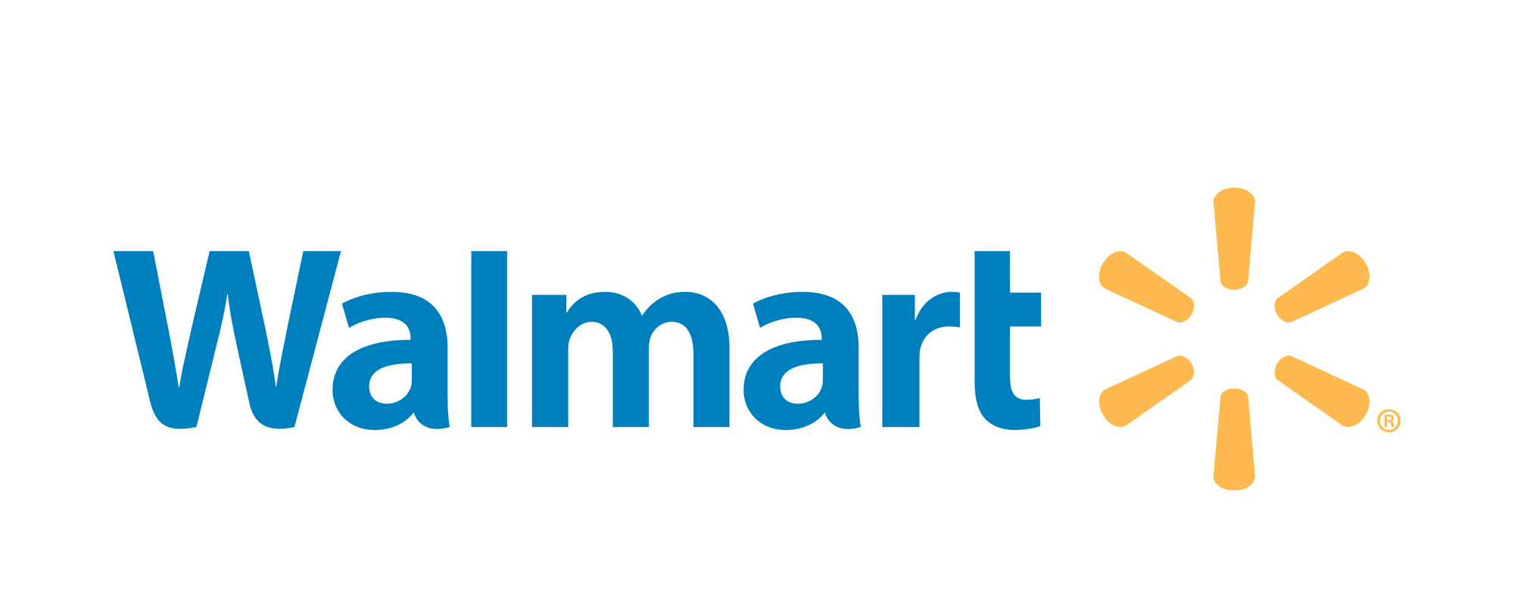
Smart Shelves Get Smart
AJ Ledesma, Sarah Orth,
Sydney Ouellette, Tyler Williams

Slide 2
Agenda
Issue: Maintaining Inventory
Solution: The Smartshelf
Tech Talk
Financial investment
Risks
Business Impact
Conclusion

Slide 3
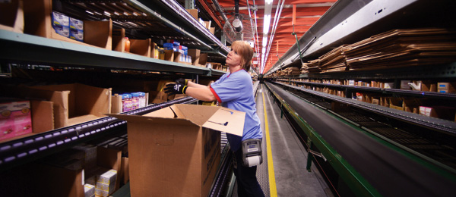
Issue: Maintaining Inventory

Slide 4
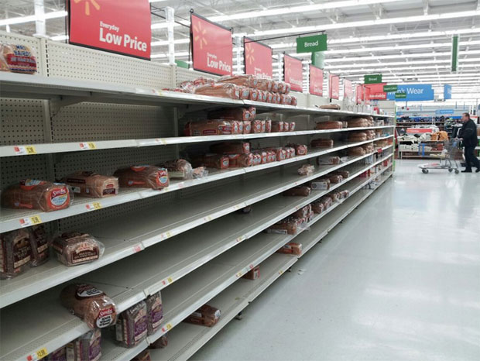
Issue: Maintaining Inventory
Notes:
21-43% of people going to competitors

Slide 5
$1.29-$2.58 billion
Cost of Walmart’s potential loss of sales annually due to meager inventory levels.
Notes:
Walmart claims to have 90-95% in-stock position, that potential 5-10% will result in this amount

Slide 6
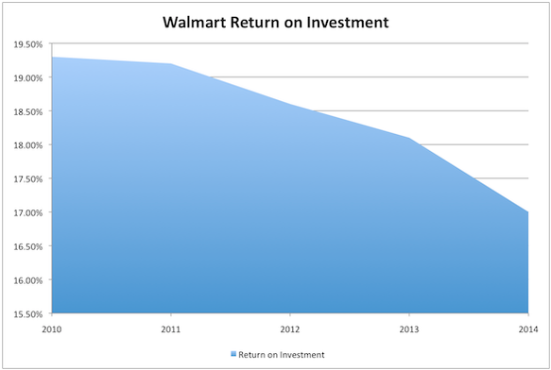
Where Should We Start?
Return on Investment (ROI) decrease since 2010
Decrease in same-store sales
Growing competition against online retailers (Amazon)
Struggling quarterly operating margins and profitability
Notes:
WHAT the IT does
You can see below that Wal-Mart's ROI is dropping rapidly since 2010, despite the broader economy recovering over that time.
If Walmart continues on this downward trend, it will soon be put in the same plummeting position that has affected other retailers like Sears, and Kmart.
Current focus is on smaller footprint store investments
Smart shelves used to enhance the “smaller is better” angle that Walmart is currently taking by allowing resegment into an existing market by employing a new niche strategy.
http://www.fool.com/investing/general/2014/05/17/walmart-is-falling-apart-before-our-eyes.aspx
http://business.time.com/2014/02/24/walmarts-big-push-to-go-small-and-destroy-your-neighborhood-dollar-store/
http://www.forbes.com/sites/walterloeb/2014/06/16/why-walmart-suddenly-thinks-smaller-is-better/

Slide 7
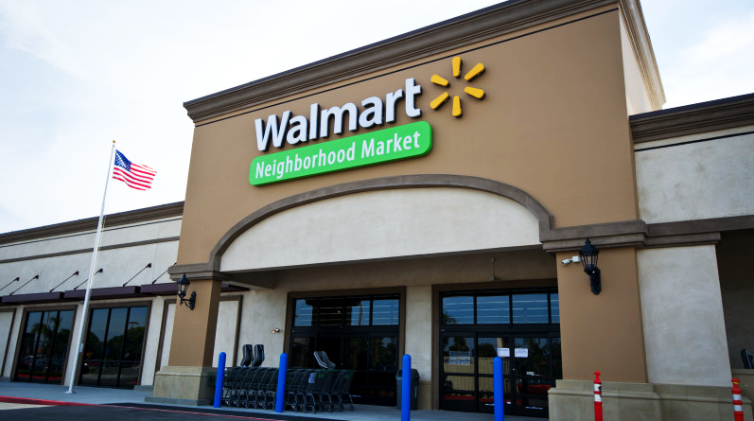
Walmart Neighborhood Market

Slide 8
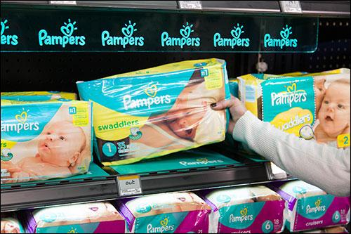
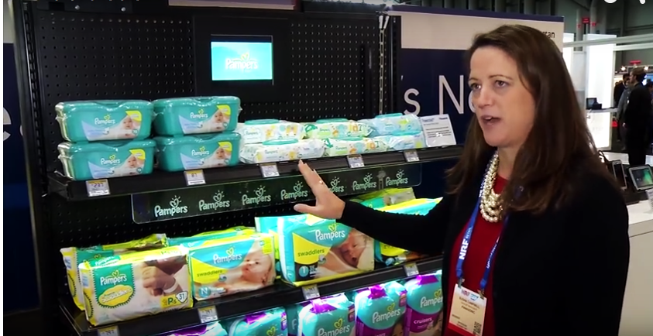
Solution: Panasonic Retail Powershelf
Shelves with an automatic pricing and weight sensor mechanism to help you track and control your inventory.
Notes:
Real-time inventory tracking device
An advertising mechanism
Alerts manager when inventory levels are low
“The overall framework will help enhance the performance of the sales outlets and improve the customer service, while addressing the time effect issue of the popular commodity.”

Slide 9
Tech Talk: How Does it Work?
Notes:
HOW the IT works
Traditional:
Current system runs on POS and physical checking.
The majority of this occurs at the end of the day, when the store is closed, and after customers have left the store empty-handed.
Weight Sensor- once there’s change in weight on the sensor pad, then RFID signals back end system that signifies the associates
Database of Inventory- single central cloud system
Product Configuration- input product via weight sensor and is then stored in the Database system
RFID Chips- used to connect the shelf display and weight sensor to the central system
Shelf Display- updates prices, value of product, or stock status

Slide 10
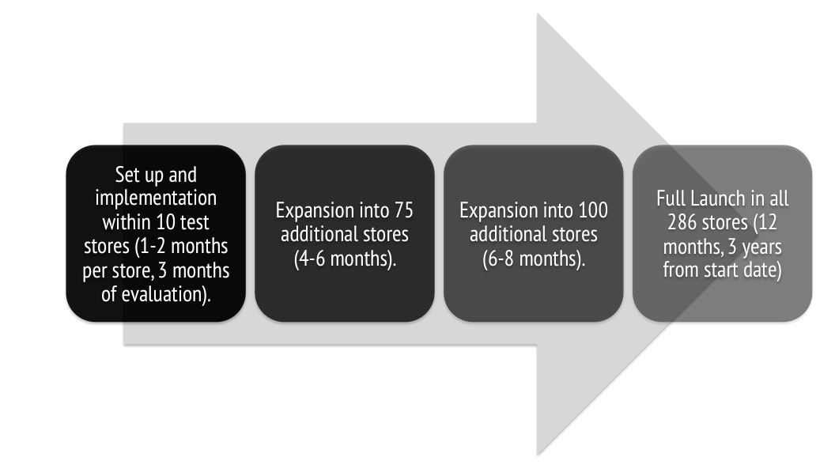
Integration Timeline
Notes:
IMPACT on business

Slide 11
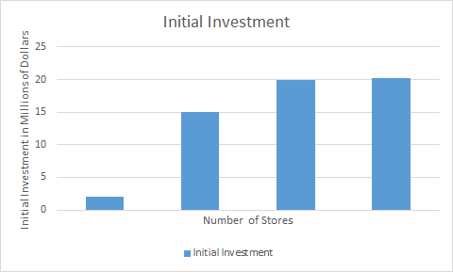
Initial Investment
The average Walmart Neighborhood Market is 40,000 square feet, creating an initial investment of approximately $200,000 per store.
Total initial investment after expanding to 286 locations:
$57.2 Million
10
75
100
101

Slide 12
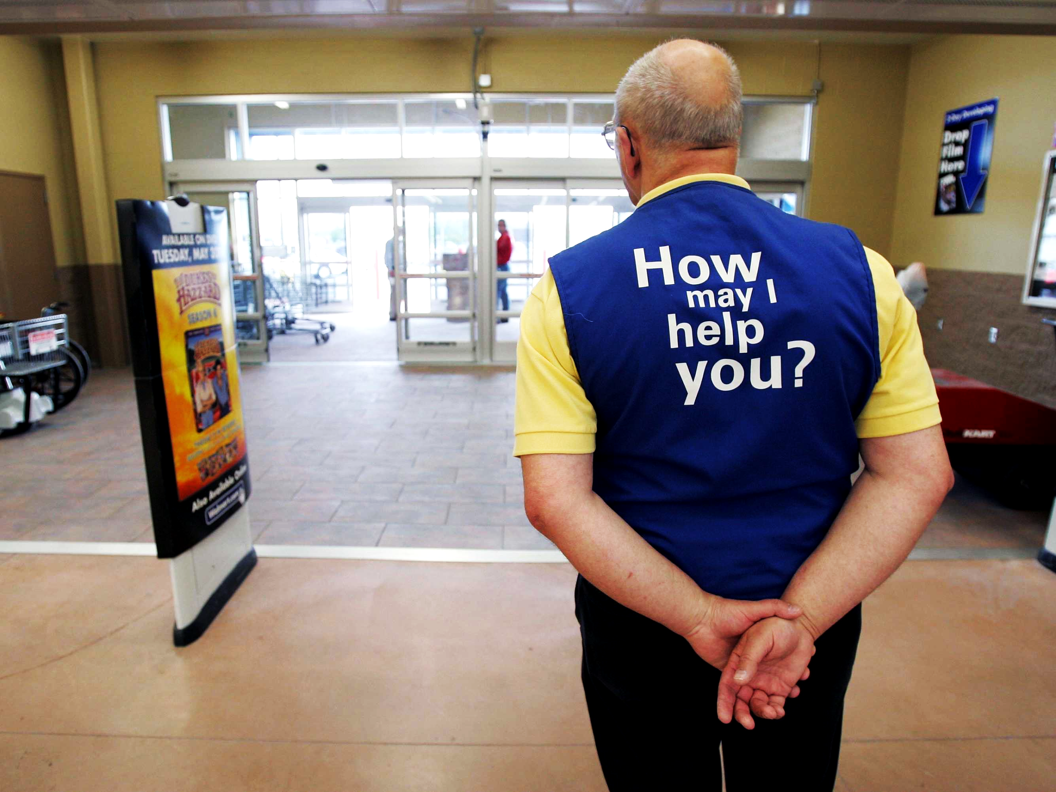
Potential Risks
Purchase and Installation
Employee Training
Long-term ROI
Risk with Untested Product
Notes:
can attach to existing infrastructure, lower cost than you would think
Ease of installation: The solution can be added directly to the front of existing retail shelving infrastructure, reducing the need for costly overhauls and the resulting customer disruptions.

Slide 13
Impact on Customer
Improve customer relations
Attract customers via new technology
Increase customer interaction
Provides consumers with more transparent product information
Notes:
capitalize on novelty
niche strategy
maintain and improve customer relations through meeting the customer’s inventory needs

Slide 14
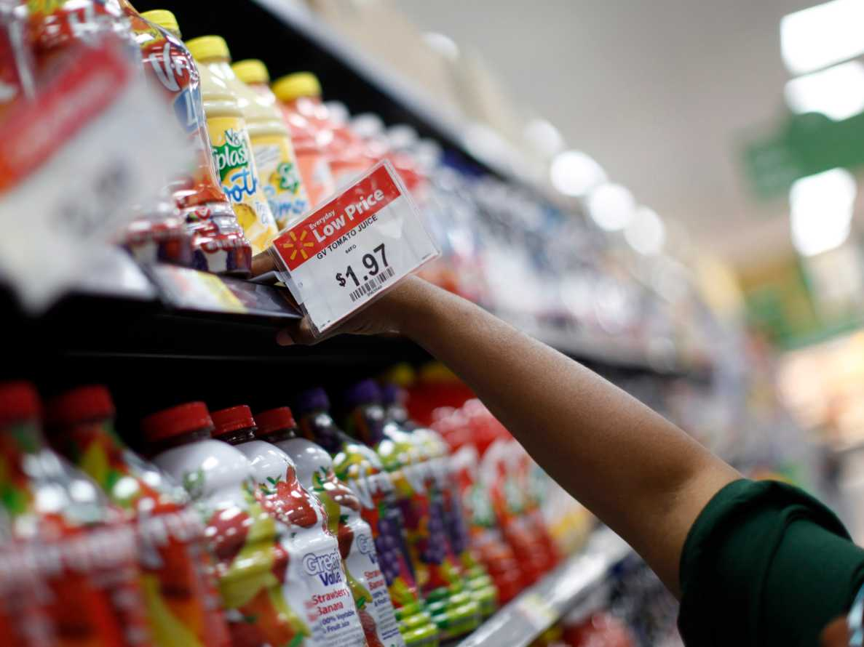
Impact on Business
Maintain inventory levels
Faster ordering and billing process
Decrease time effect issue, updates prices automatically
Potential advertising opportunities

Slide 15
Thank You!

