Slide 1
Hydroelectric Desalination: The Solution to India’s Water Crisis
by Andy Hazelnis, Philip Tschepik, and Anastasia Tsimberlidis

Slide 2
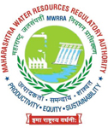

Slide 3
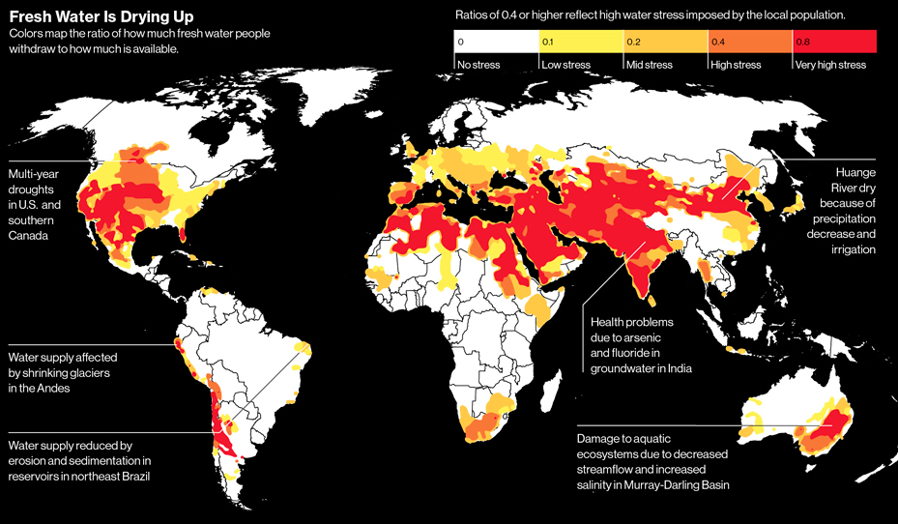
The Global Water Crisis: Spotlight India
1B people lack access to drinking water
Water-related diseases - 21%
Lack of Traditional Sanitation - 33% of population
1.6 billion by 2050
Long-term availability of replenishable water resources

Slide 4
Hydroelectric Desalination

Slide 5
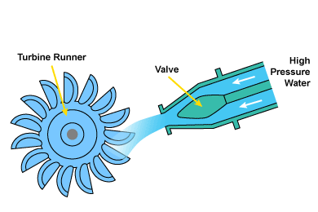
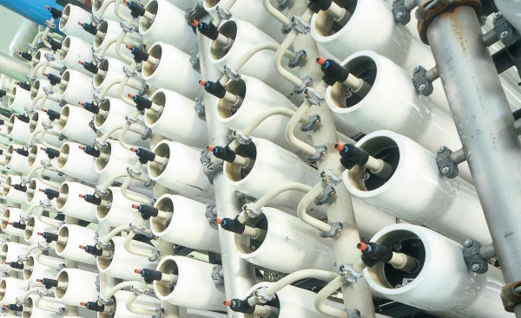
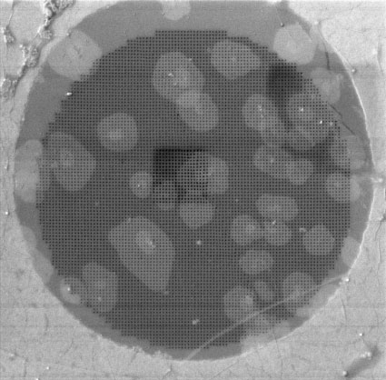
How It Works
Notes:
-improving and expanding on Sorek model in Israel
Reverse osmosis
16” diameter vertically stacked membranes
Innovative Atom-thick carbon material called Graphene
Reduces energy and materials costs
Less pressure required because 1,000x stronger than steel and has nanometer size holes
Produces drinking water
Brine forced through specially designed pipes and into turbines at a decline of 10 feet
90% of brine converted into electricity that can be used by the government to supplement certain gaps in the electrical infrastructure of Maharashtra
Excess brine injected into soil
Provides crops with vital sodium
-Every gallon of water produced, another of brine is produced

Slide 6
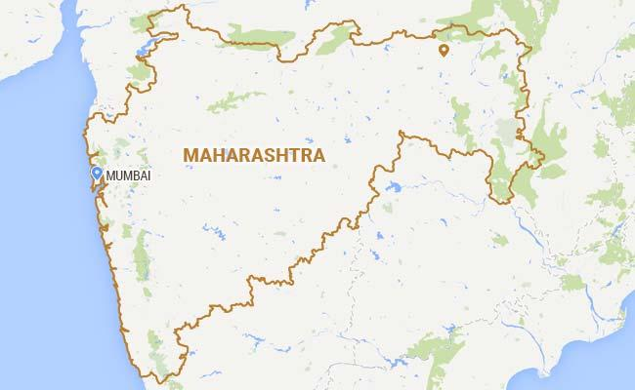
Financial Details
Estimated cost to build
$500-650M
Fully operational in three years
Potable Water Production capacity
624,000 m³/day
Electricity produced
9.2 million kWh
Notes:
Estimated cost to build
$500-600 million
Fully operational in three years
Potable Water Production capacity
624,000 m³/day (250 Olympic size swimming pools) or 150 million m³/year of water a year
Electricity produced
Maharashtra largest power generating state
9.2 million kWh
Enough to supply the towns of Shahapur, Zotirpada, and Isasani
Ag. hubs for the many networks of small rural villages

Slide 7
Impact on India

Slide 8
Implications of Desalination in India
Reliable water supply source
Easy to transport
Monsoons
insufficient crops or overproduction hard to conserve
Desertification - 25%
Land Degradation - 32%

Slide 9
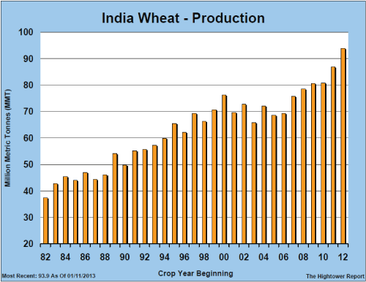
Byproducts of Desalination and Agriculture
Brine as a byproduct of Desalination
Wheat as a cereal product of India
NaCl Fertilization of Wheat
Increases defense mechanisms in plants to survive stress factors and reduce disease incidence.
Sodium as a substitute for potassium
Chloride strengthens root/soil relations
Notes:
Wheat is the main cereal crop in India, with the use of NaCl in fertilization, India can better protect their largest cereal crop from the potential dangers that their climate presents.
The total area under the crop is about 29.8 million hectares throughout the country (Farmer Portal). The effects of chloride salts on wheat diseases have been studied more thoroughly than any other crop.
A 1978 study that was conducted on six cultivars of wheat resulted in a 63% average reduction in disease incidence.

Slide 10
Challenges

Slide 11
Potential Concerns
World Bank Country Frontier: India | Rank (1-189) | Overall Distance to Frontier Score (1-100)
Ease of Doing Business | 142 | 54
Getting Electricity | 137 | 63.1
Getting Credit | 36 | 65
Enforcing Contracts | 186 | 25.1
Environmental Challenges
Political Challenges
Notes:
-Selling excess capacity can be difficult when it comes to transport (varying tariffs and tax rates/poor infrastructure)
-New utility in Mumbai makes it cheaper to register a new connection to electricity
-Working directly with government would mitigate many of these issues

Slide 12
Questions?

Slide 13
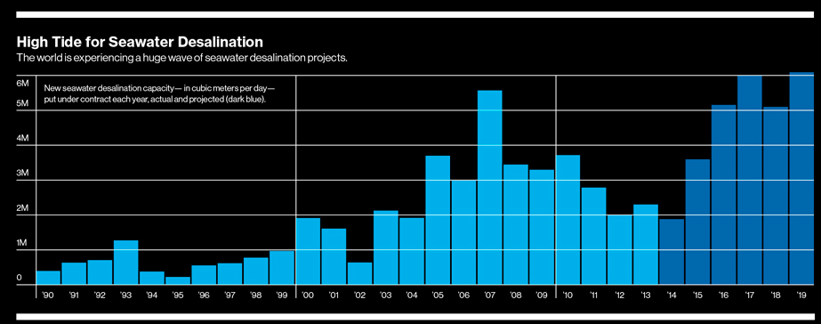
Appendix
Power = (10 feet) x (1271.33 cubic feet per second) x (0.98) / 11.8 = 1055.85 kilowatts
Electric Energy = ( 1055.85 kilowatts) x (24 hours per day) x (365 days per year) = 9,249,246 kilowatt hours
People Served = (9,249,246 kilowatts-hours) / (648 kilowatt-hours per person) = 14,274 people.
Gallon = .0038m³

